Slide 1
Scholarship
For
Level 3 Biology Students

Slide 2
What is required to achieve scholarship?
Scholarship candidates are expected to demonstrate high-level critical thinking, abstraction and generalisation, and to integrate, synthesise and apply knowledge, skills, understanding and ideas to complex situations.
NZQA: http://www.nzqa.govt.nz/qualifications-standards/awards/scholarship

Slide 3
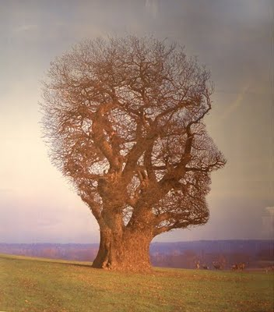
And
Depending on the area of study, a student will display a range of:
comprehensive content knowledge (breadth and depth)
effective communication
original or sophisticated solutions, performances or approaches
critical evaluation
flexible thinking in unfamiliar/unexpected contexts.

Slide 4
Parameters of the New Zealand Scholarship Performance Standards
They:
are derived from the achievement objectives at Level 8 of the NZC (2007) and/ or related documents
assume lower level knowledge and skills
expect students to demonstrate the critical thinking skills mentioned earlier
Notes:
One outcome of the alignment of standards with the NZC is an increase in the overall number of achievement standards, and hence, an increase in the total available credits through achievement standards at each level of the NCEA. This increase has made possible the assessment of knowledge and skills previously assessed using unit standards. A consequence of this increase is that schools can retain flexibility in course design to meet the particular interests and needs of their students. Schools need to continue to ensure that their course pathways include critical aspects of any subject, for students intending to pursue further study. This includes preparation for New Zealand Scholarship.
Think of your course at Level 3. How many of the level 3 standards are used for its assessment. It is unlikely to be the full suite for good assessment and learning reasons.
The criteria for a subject to be included in New Zealand Scholarship are as follows:
1. Curriculum or government goals:
the range of Scholarship subjects are derived from New Zealand Curriculum up to and including Level 8 and the subject Teaching and Learning Guides
Scholarship subjects recognise two of New Zealand's official languages (te reo Māori and English; with sign language being the third,
Scholarship subjects meet government goals about the future direction of the country.
2. Subject maturity:
significant numbers of candidates have shown the ability to perform with excellence at Level 3
there are writers and markers available of sufficient calibre and experience in this subject to produce quality assessment for students at the appropriate level
there is an appropriate tertiary path for Scholarship students in this subject
the subject has the capacity to permit students to exhibit the high-level cognitive abilities for the credibility of the Scholarship examination
3. Practical aspects:
sufficient candidates to make the most efficient and effective use of resources;
the proposed mode of assessment is logistically manageable; and
running the external assessment is possible within the agreed cost parameters.
Review Cycle
A review is carried out every two years to determine whether a current or proposed subject fulfils the requirements to be included on the New Zealand Scholarship subject List. The review is carried out in consultation with the Ministry of Education and includes sector interest groups. Any additions or deletions to the current List of subjects for New Zealand Scholarship are carefully considered before recommendations are made.

Slide 5
The Current New Zealand Scholarship Performance Standards
New Zealand Scholarship Performance Standards have:
been developed with two generic performance descriptors for ‘Scholarship’ and ‘Outstanding Scholarship’. This means that in all subjects the first part of the Performance Standard starts the same’
Where necessary, subject specific information and definitions are included in the Explanatory Notes. Scholarship Biology has seven of these.

Slide 6
and
Scholarship examination papers or formats of assessment for 2018 are not expected to differ significantly from those for previous years
However it is important that the Performance Standard and the Assessment Specifications for the current year are addressed when preparing for assessment
The Assessment Specifications for Biology for 2018 can be found at
http://www.nzqa.govt.nz/qualifications-standards/awards/new-zealand-scholarship/scholarship-subjects/scholarship-biology/
Notes:
There are sample tasks based on the 2011 examinations to exemplify the expectations of the new standards are available on our website.

Slide 7
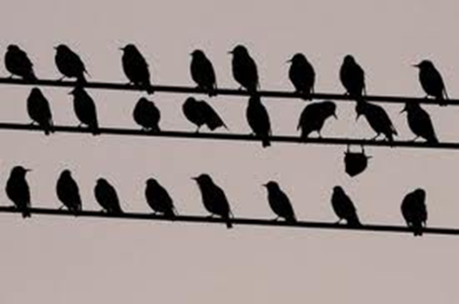
Who gets Scholarship
Provided the standard is met:
Scholarship will be awarded to 3% of the Level 3 cohort, plus or minus 0.25%
Outstanding will be awarded to 0.3% to 0.4% of the Level 3 cohort
For small cohorts (< 1000 candidates), the 3% figure may vary by plus or minus 5 candidates.
Notes:
The Level 3 cohort is defined as students in Year 13 or above who have achieved credits in internal standards at Level 3 and/or entered external standards at Level 3 totalling 14 credits. The cohort is calculated on the first day of the examination period and confirmed on the 1st of December.
If you are wondering why the birds, we are finding the candidates who stand out in the way they can manage situations by thinking and using skills that make them outstanding in the group.

Slide 8
How is each Standard Assessed
NZQA has a group of Education experts who advise them with assessment management and best practise. They have said that there should be a minimum of 3 and a maximum of 6 components to be assessed for each subject. For Biology this is 3 again for 2018.
They have also said that each component assessed should be designed to elicit unique information about candidates abilities.
Notes:
TOGA stands for Technical Overview Group Assessment the are a group of very learned educationalists who provide independent expert advice to NZQA and the Ministry of Education on the assessment processes for New Zealand Scholarship and NCEA. It is made up of people such as Professors Gary Hawke, Cedric Hall, Terry Crookes, Geoff Smith, Gavin Brown and Michael Johnston. They meet with us for two days in January to decide on the final cut scores for Scholarship and Outstanding Scholarship for each subject and then decide on the overall Premier and outstanding monetary awards as well as advising us on processes.
Less than three components does not give enough information to spread the candidates and for content based subjects especially the up to 6 compnents allows the range of subject matter from the curriculum to be assessed.
Correlation between the components should not exceed 0.7.

Slide 9
Marking
Each component is marked using a 0 – 8 scale
Marks of 7 and 8 indicate outstanding performance for that component
Marks of 5 and 6 indicate scholarship performance for that component
Marks of 1 to 4 indicate some understanding relevant to the question
0 means there is no relevant information given
Notes:
Each scholarship standard has performance descriptors.
The attributes required for outstanding scholarship so a mark of 8 means that the candidate response is outstanding in all respects. It shows strong evidence of integration and synthesis. As good as could be expected under examination conditions. Accurate, comprehensive, coherent, lucid, perceptive.
The marks for each component are then added to produce the overall mark.

Slide 10
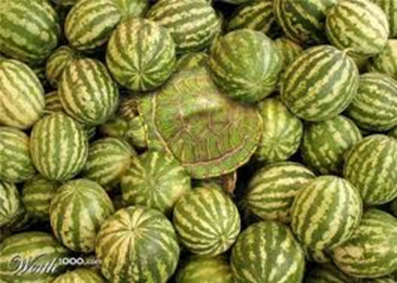
The Challenge of the Standards
Scholarship candidates are expected to:
demonstrate high-level critical thinking, abstraction and generalisation,
and
to integrate, synthesise and apply knowledge, skills, understanding and ideas to complex situations.
Notes:
These candidates typically work at excellence level for NCEA but are the ones that stand out because of their cognitive skills.

Slide 11
What is critical thinking?
"We understand critical thinking to be purposeful, self-regulatory judgment that results in interpretation, analysis, evaluation, and inference, as well as explanation of the evidential, conceptual, methodological, criteriological, or contextual considerations upon which that judgment is based.” (Delphi report 1990)

Slide 12
Resources
Available on the NZQA website :
Previous years work and exemplars are available from the subject resources pages from the website:
http://www.nzqa.govt.nz/ncea/subjects/biology/levels/
Or from the scholarship pages themselves at:
http://www.nzqa.govt.nz/qualifications-standards/awards/new-zealand-scholarship/scholarship-subjects/

Slide 13
Resources

Slide 14
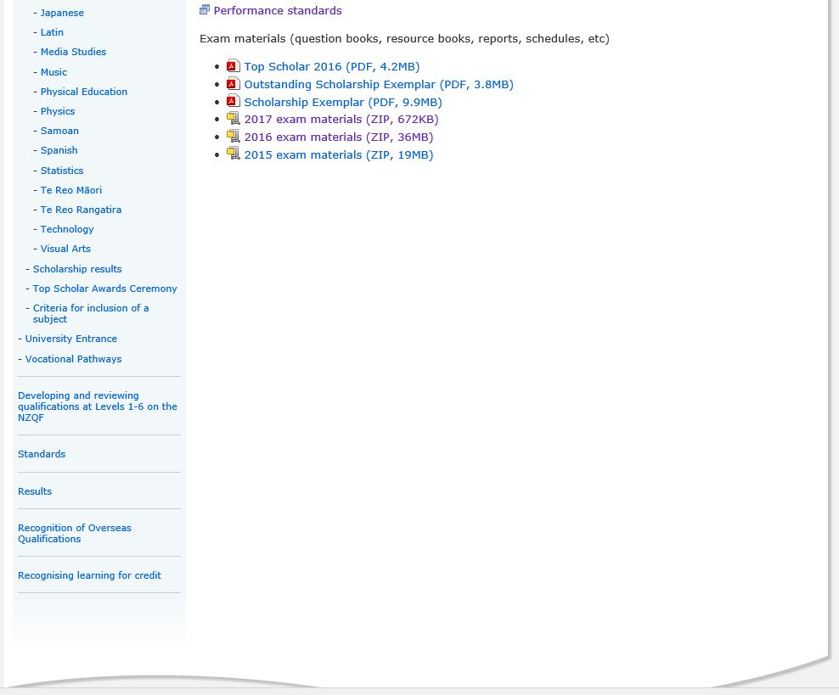

Slide 15
Questions Please
Constructive comments, like rain, should be gentle enough to nourish growth without destroying its roots.

