Slide 1
STEMM Student Challenge 2017

Slide 2
QUESTIONS
ROUND 1 Junior Section Years 9-10

Slide 3
Q1
In terms of electricity, what does DC stand for?

Slide 4
Q2
What is the chemical symbol for gold?

Slide 5
Q3
What is five percent of 50?

Slide 6
Q4 Who is this famous scientist?

Slide 7
Q5
What blood group do you belong to if you're a universal donor?

Slide 8
Q6
Did the original Sony Playstation use CDs or cartridges to play games?

Slide 9
Q7
What happens to pearls when dropped in vinegar?

Slide 10
Q8
What Peruvian word is the name given to seabird droppings used as fertiliser?

Slide 11
Q9
What natural plant process gets its name from the Greek words meaning "light" and "together"?

Slide 12
Q10
Did the Apple iPhone first become available in 2005, 2006 or 2007?

Slide 13
ANSWERS
ROUND 1 Junior Section Years 9-10

Slide 14
Q1: In terms of electricity, what does DC stand for?
Answer: Direct current

Slide 15
Q2: What is the chemical symbol for gold?
Answer: Au

Slide 16
Q3: What is five percent of 50?
Answer: Two and a half

Slide 17
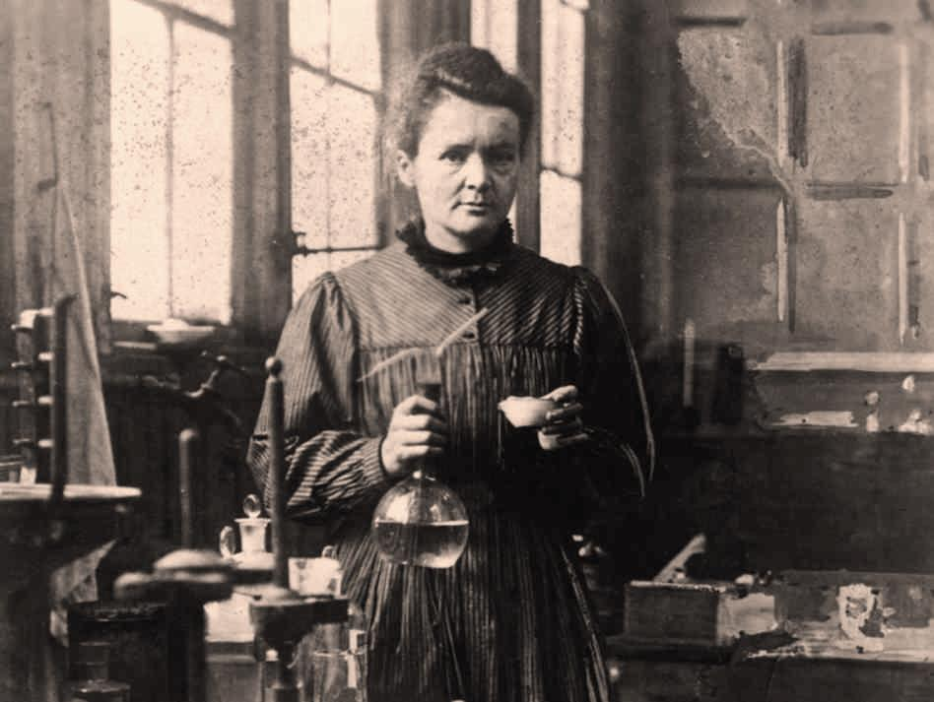
Q4:
Answer: Marie Curie

Slide 18
Q5: What blood group do you belong to if you're a universal donor?
Answer: O

Slide 19
Q6: Did the original Sony Playstation use CDs or cartridges to play games?
Answer: CDs

Slide 20
Q7: What happens to pearls when dropped in vinegar?
Answer: They melt/dissolve

Slide 21
Q8: What Peruvian word is the name given to seabird droppings used as fertiliser?
Answer: Guano

Slide 22
Q9: What natural plant process gets its name from the Greek words meaning "light" and "together"?
Answer: Photosynthesis

Slide 23
Q10: Did the Apple iPhone first become available in 2005, 2006 or 2007?
Answer: 2007

Slide 24
QUESTIONS
ROUND 2 Junior Section Years 9-10

Slide 25
Q11
What is the medical name for the windpipe?

Slide 26
Q12
How many degrees are there in a quadrilateral?

Slide 27
Q13
What's the metric prefix for "millionth"?

Slide 28
Q14
True or false? Electrons are not part of the nucleus?

Slide 29
Q15
What do you call molten rock before it has erupted?

Slide 30
Q16
What did pessimist Hyman L. Lipman add to pencils in 1858?

Slide 31
Q17
What are the first three arabic numerals?

Slide 32
Q18
What does a cicada pass through its ovipositor?

Slide 33
Q19
The Panama Canal joins which two oceans?

Slide 34
Q20
What is it called when a solid changes directly into a gas?

Slide 35
ANSWERS
ROUND 2 Junior Section Years 9-10

Slide 36
Q11: What is the medical name for the windpipe?
Answer: Trachea

Slide 37
Q12: How many degrees are there in a quadrilateral?
Answer: 360

Slide 38
Q13: What's the metric prefix for "millionth"?
Answer: Micro

Slide 39
Q14: True or false? Electrons are not part of the nucleus?
Answer: True

Slide 40
Q15: What do you call molten rock before it has erupted?
Answer: Magma

Slide 41
Q16: What did pessimist Hyman L. Lipman add to pencils in 1858?
Answer: Erasers/Rubbers

Slide 42
Q17: What are the first three arabic numerals?
Answer: 1, 2, 3

Slide 43
Q18: What does a cicada pass through its ovipositor?
Answer: Eggs

Slide 44
Q19: The Panama Canal joins which two oceans?
Answer: Atlantic and Pacific

Slide 45
Q20: What is it called when a solid changes directly into a gas?
Answer: Sublimation

Slide 46
PRACTICAL TASK

Slide 47
PRACTICAL TASKS
1. Identify the vegetables A, B, C, D
2. You have 3 minutes to identify by touch, the 4 fruit in the box
3. Identify the 4 native birds A, B, C, D
4. Cut a square of paper with an area of 400cms squared
5. Place 100grams of sugar in the clear plastic cup

Slide 48
PRACTICAL TASK
ANSWERS

Slide 49
PRACTICAL TASKS ANSWERS
1. A = Lettuce B = Spinach
C = Silverbeet D = Kale
2. Mandarin, Lemon, Pear, Feijoa
3. A = Tui B = Kiwi
C = Morepork (Ruru) D = Kea
4. 200 – 600 sq.cm = 1pt
300 – 500 sq.cm = 2pt
5. 90 – 110 grams = 1pt
95 – 105 grams = 2pt

Slide 50
QUESTIONS
ROUND 4 Junior Section Years 9-10

Slide 51
Q21
What maternal product do baby Koalas consume besides milk?

Slide 52
Q22
What grain has the highest level of worldwide production? (Hint: Rice is second)?

Slide 53
Q23
What letter denotes 1,024 bytes of memory in computer lingo?

Slide 54
Q24
Phobos and Deimos are moons of what planet?

Slide 55
Q25
Which is higher - the stratosphere or the troposphere?

Slide 56
Q26
What nationality was Erno Rubik, inventor of the Rubik's Cube?

Slide 57
Q27
A clock that reads 4:30 is placed on a table so that the minute hand points East. In what direction is the hour hand pointing? A. N B. NW C. NE D. SE ?

Slide 58
Q28
Infrared light has a wavelength that is too long or short to be visible for humans?

Slide 59
Q29
True or false? Formic acid is found in bee venom?

Slide 60
Q30 Who is this famous scientist?

Slide 61
ANSWERS
ROUND 4 Junior Section Years 9-10

Slide 62
Q21: What maternal product do baby Koalas consume besides milk?
Answer: Faeces

Slide 63
Q22: What grain has the highest level of worldwide production? (Hint: Rice is second)?
Answer: Maize (corn)

Slide 64
Q23: What letter denotes 1,024 bytes of memory in computer lingo?
Answer: K

Slide 65
Q24: Phobos and Deimos are moons of what planet?
Answer: Mars

Slide 66
Q25: Which is higher - the stratosphere or the troposphere?
Answer: The stratosphere

Slide 67
Q26: What nationality was Erno Rubik, inventor of the Rubik's Cube?
Answer: Hungarian

Slide 68
Q27: A clock that reads 4:30 is placed on a table so that the minute hand points East. In what direction is the hour hand pointing? A. N B. NW C. NE D. SE
Answer: C

Slide 69
Q28: Infrared light has a wavelength that is too long or short to be visible for humans?
Answer: Long

Slide 70
Q29: True or false? Formic acid is found in bee venom?
Answer: True

Slide 71
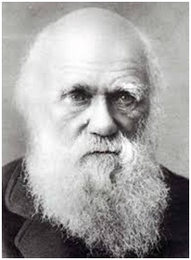
Q30:
Answer: Charles Darwin

Slide 72
QUESTIONS
ROUND 5 Junior Section Years 9-10

Slide 73
Q31
What is the name given to substances that are initially involved in a chemical reaction?

Slide 74
Q32
The bones that make up your spine are called what?

Slide 75
Q33
What do molluscs extract from water to build their shells?

Slide 76
Q34
What's the international radio code word for the letter E?

Slide 77
Q35
Which of the senses does the olfactory nerve serve?

Slide 78
Q36
True or false? Ammonia is an acid?

Slide 79
Q37
What name is given to the space between two adjacent neurones?

Slide 80
Q38
Is a mangonel a type of catapult or bridge?

Slide 81
Q39
What is the cube root of 216?

Slide 82
Q40
A nuclear reaction where the nucleus of an atom splits into smaller parts is known as nuclear fission or nuclear fusion?

Slide 83
ANSWERS
ROUND 5 Junior Section Years 9-10

Slide 84
Q31: What is the name given to substances that are initially involved in a chemical reaction?
Answer: Reactants

Slide 85
Q32: The bones that make up your spine are called what?
Answer: Vertebrae

Slide 86
Q33: What do molluscs extract from water to build their shells?
Answer: Calcium carbonate, or lime

Slide 87
Q34: What's the international radio code word for the letter E?
Answer: Echo

Slide 88
Q35: Which of the senses does the olfactory nerve serve?
Answer: Smell

Slide 89
Q36: True or false? Ammonia is an acid?
Answer: False

Slide 90
Q37: What name is given to the space between two adjacent neurones?
Answer: Synapse

Slide 91
Q38: Is a mangonel a type of catapult or bridge?
Answer: Catapult

Slide 92
Q39: What is the cube root of 216?
Answer: 6

Slide 93
Q40: A nuclear reaction where the nucleus of an atom splits into smaller parts is known as nuclear fission or nuclear fusion?
Answer: Nuclear fission

Slide 94
Well done to all teams participating in STEMM Student Challenge 2017
huttscience.co.nz

Slide 95
TIE BREAKER

Slide 96
Question
An anemometer is used to measure what?

Slide 97
Answer
Wind speed

Slide 98
Question
True or false? Steel is a chemical element?

Slide 99
Answer
False - Alloy

Slide 100
Question
What is the square root of 0.0081 A. 0.09 B. 0.9 C. 0.91 D. 0.009 ?

Slide 101
Answer
A

Slide 102
Question
The muscles found in the front of your thighs are known as what?

Slide 103
Answer
Quadriceps

Slide 104
Question
How many dimensions would the shadow of a four-dimensional object have?

Slide 105
Answer
Three

Slide 106
Question
How many sides does a nonagon have?

Slide 107
Answer
9

Slide 108
Question
A single piece of coiled DNA is known as a?

Slide 109
Answer
Chromosome

Slide 110
Question
True or false? Venus has more atmospheric pressure than Earth?

Slide 111
Answer
True

Slide 112
Question
What's the term for a plant that lives more that two years?

Slide 113
Answer
Perennial

Slide 114
Question
'Cascade', 'horsetail', 'plunge' and 'tiered' are types of what?

Slide 115
Answer
Waterfall

