Slide 1
STEMM Student Challenge 2019

Slide 2
QUESTIONS
ROUND 1 Intermediate Section Years 7-8

Slide 3
Q1
What is the seventh planet from the Sun?

Slide 4
Q2
True or false? The particles of a gas are packed tightly together?

Slide 5
Q3
If you suffer from 'insomnia', you cannot do what?

Slide 6
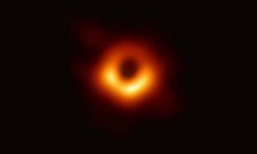
Q4
This image was captured for the first time ever this year.
What is it of?

Slide 7
Q5
The Māori word 'pāngarau' refers to what? A: Science B: Technology C: Engineering D: Maths?

Slide 8
Q6
What type of material is 'mahogany'?

Slide 9
Q7
Name the main gas found in fizzy drinks?

Slide 10
Q8
What is the left side of a ship called?

Slide 11
Q9
Which insect carries malaria?

Slide 12
Q10
What do you call the small image icons used to express emotions or ideas in digital communication?

Slide 13
ANSWERS
ROUND 1 Intermediate Section Years 7-8

Slide 14
Q1: WHAT IS THE SEVENTH PLANET FROM THE SUN?
ANSWER: URANUS

Slide 15
Q2: TRUE OR FALSE? THE PARTICLES OF A GAS ARE PACKED TIGHTLY TOGETHER?
ANSWER: FALSE

Slide 16
Q3: IF YOU SUFFER FROM 'INSOMNIA', YOU CANNOT DO WHAT?
ANSWER: SLEEP

Slide 17
Q4: THIS IMAGE WAS CAPTURED FOR THE FIRST TIME EVER THIS YEAR. WHAT IS IT OF?
ANSWER: A BLACK HOLE

Slide 18
Q5: THE MĀORI WORD 'PĀNGARAU' REFERS TO WHAT? A: SCIENCE B: TECHNOLOGY C: ENGINEERING D: MATHS?
ANSWER: D: MATHS

Slide 19
Q6: WHAT TYPE OF MATERIAL IS 'MAHOGANY'?
ANSWER: WOOD

Slide 20
Q7: NAME THE MAIN GAS FOUND IN FIZZY DRINKS?
ANSWER: CARBON DIOXIDE

Slide 21
Q8: WHAT IS THE LEFT SIDE OF A SHIP CALLED?
ANSWER: PORT

Slide 22
Q9: WHICH INSECT CARRIES MALARIA?
ANSWER: MOSQUITO

Slide 23
Q10: WHAT DO YOU CALL THE SMALL IMAGE ICONS USED TO EXPRESS EMOTIONS OR IDEAS IN DIGITAL COMMUNICATION?
ANSWER: EMOJI

Slide 24
QUESTIONS
ROUND 2 Intermediate Section Years 7-8

Slide 25
Q11
A farmer fences a paddock in the shape of a regular Hexagon. He counts up and finds that he has 22 posts along one fence line. How many posts will be in the entire fence line?

Slide 26
Q12
What do you call a person who studies rocks?

Slide 27
Q13
A 'spirit level' tells if things: (a) are horizontal? (b) contain alcohol? (c) are underground?

Slide 28
Q14
Which makes the biggest contribution to rising sea levels; Land Ice or Sea Ice?

Slide 29
Q15
A young Isaac Newton is said to have been hit on the head by which fruit, leading him to come up with the theory of gravity?

Slide 30
Q16
True or false? Iron is attracted by magnets?

Slide 31
Q17
What is the name of the biggest part of the human brain?

Slide 32
Q18
True or false? Opposite angles of a parallelogram are equal.?

Slide 33
Q19
What is a male elephant called?

Slide 34
Q20
What element is used in microchips?

Slide 35
ANSWERS
ROUND 2 Intermediate Section Years 7-8

Slide 36
Q11: A FARMER FENCES A PADDOCK IN THE SHAPE OF A REGULAR HEXAGON. HE COUNTS UP AND FINDS THAT HE HAS 22 POSTS ALONG ONE FENCE LINE. HOW MANY POSTS WILL BE IN THE ENTIRE FENCE LINE?
ANSWER: 126

Slide 37
Q12: WHAT DO YOU CALL A PERSON WHO STUDIES ROCKS?
ANSWER: A GEOLOGIST

Slide 38
Q13: A 'SPIRIT LEVEL' TELLS IF THINGS: (A) ARE HORIZONTAL? (B) CONTAIN ALCOHOL? (C) ARE UNDERGROUND?
ANSWER: (A) ARE HORIZONTAL

Slide 39
Q14: WHICH MAKES THE BIGGEST CONTRIBUTION TO RISING SEA LEVELS; LAND ICE OR SEA ICE?
ANSWER: LAND ICE (SEA ICE MAKES ALMOST NO DIFFERENCE)

Slide 40
Q15: A YOUNG ISAAC NEWTON IS SAID TO HAVE BEEN HIT ON THE HEAD BY WHICH FRUIT, LEADING HIM TO COME UP WITH THE THEORY OF GRAVITY?
ANSWER: AN APPLE

Slide 41
Q16: TRUE OR FALSE? IRON IS ATTRACTED BY MAGNETS?
ANSWER: TRUE

Slide 42
Q17: WHAT IS THE NAME OF THE BIGGEST PART OF THE HUMAN BRAIN?
ANSWER: THE CEREBRUM

Slide 43
Q18: TRUE OR FALSE? OPPOSITE ANGLES OF A PARALLELOGRAM ARE EQUAL.?
ANSWER: TRUE

Slide 44
Q19: WHAT IS A MALE ELEPHANT CALLED?
ANSWER: A BULL

Slide 45
Q20: WHAT ELEMENT IS USED IN MICROCHIPS?
ANSWER: SILICON

Slide 46
PRACTICAL TASK
This year we have 3 practical challenges:
Year of the Periodic Table Challenge
Building Challenge
Coding Challenge

Slide 47
Year of the Periodic Table Challenge (3 marks)
What element is found in and “closely associated with” the 5 everyday items you have been given.

Slide 48
Building Challenge (4 marks)
Using only the equipment provided, build the tallest structure, as measured from the table surface to the top of the marshmallow. You have 15 minutes and should read the set of rules carefully
Over 5cm = 1 mark Over 20cm = 2 marks
Over 35cm = 2 marks Over 50cm = 4 marks

Slide 49
Coding Challenge (3 marks)
A Racetrack will be shown on screen and you must programme your team Bot to complete the circuit, from behind the Start line to over the Finish line. Instructions have been provided to each team
Reach Tyre Arch = 1 mark
Reach Man with Flag = 2 marks
Cross the finish line = 3 Marks

Slide 50
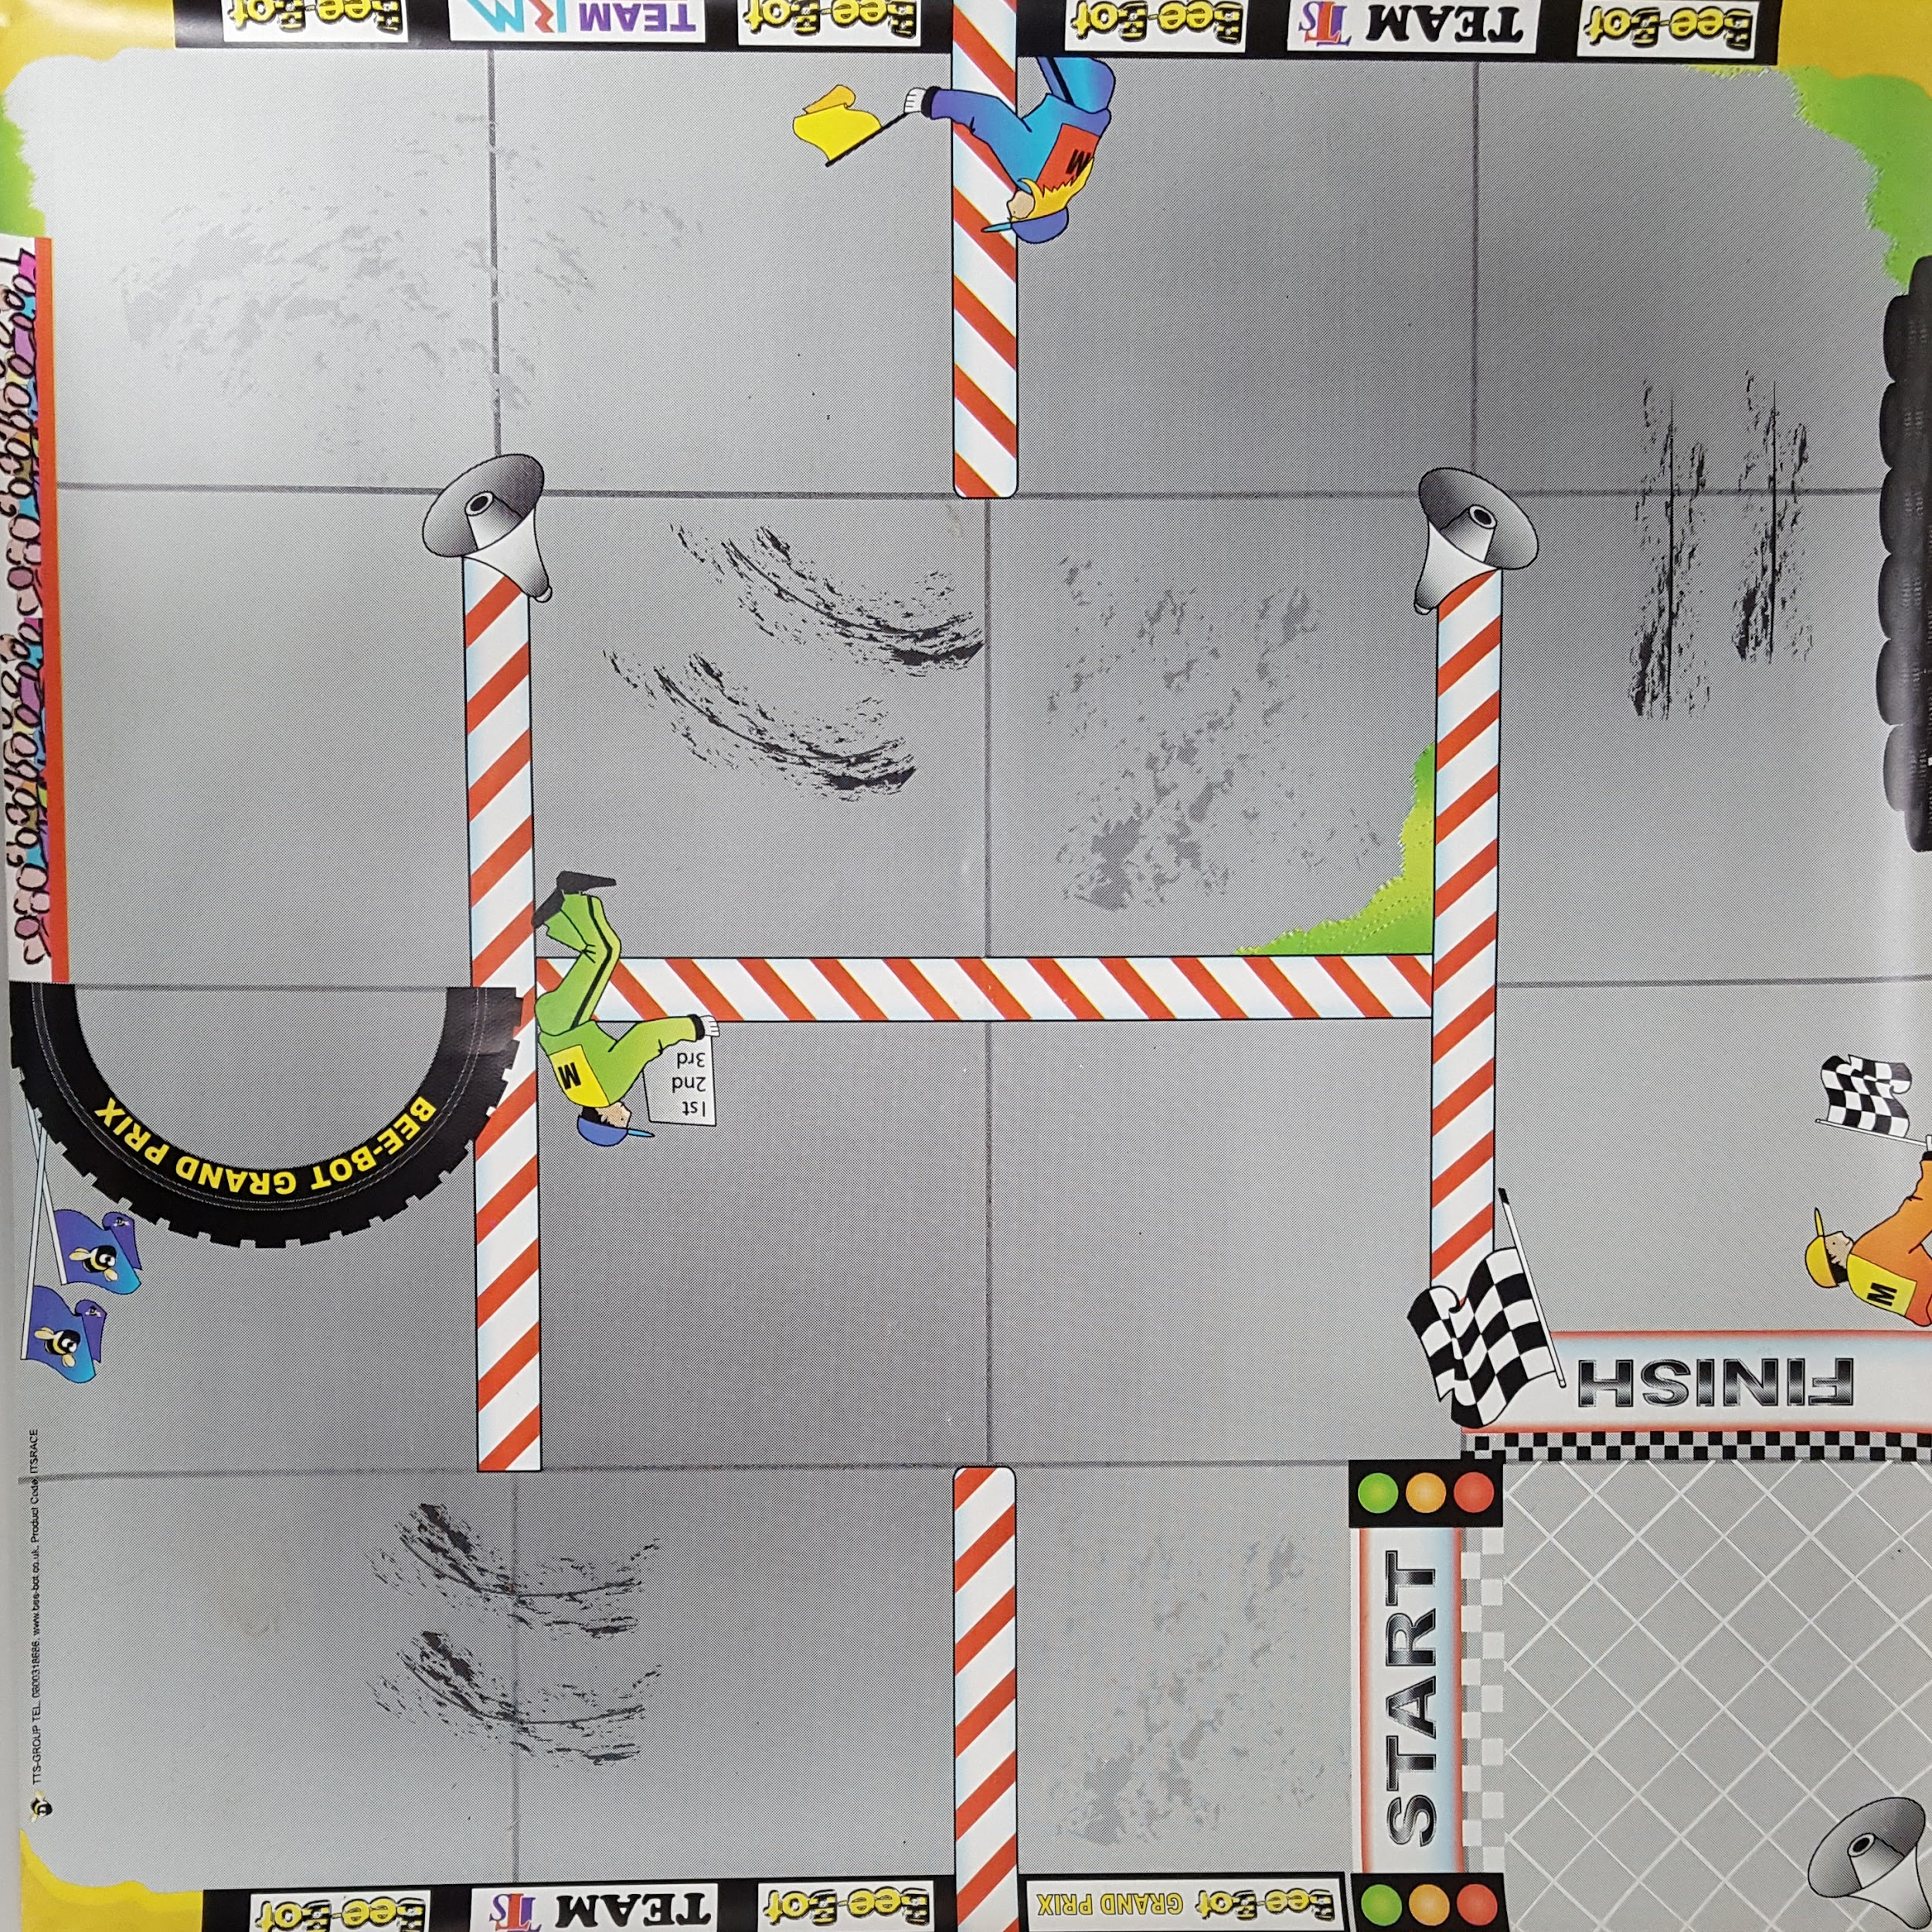

Slide 51
ELEMENT
CHALLENGE
ANSWERS

Slide 52
Year of the Periodic Table Challenge
A: Carbon D: Calcium
B: Lithium E: Hydrogen
C: Copper E: Oxygen

Slide 53
QUESTIONS
ROUND 4 Intermediate Section Years 7-8

Slide 54
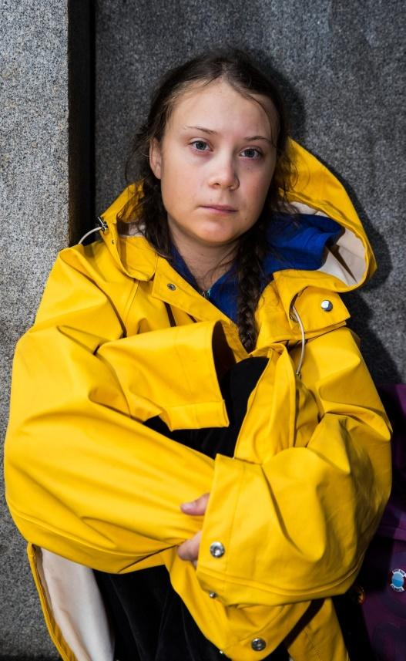
Q21
This 15 year old teenager, Greta Thunberg, became famous in 2019 for protesting against climate change. What country is she from?

Slide 55
Q22
What does the online acronym SMH stand for?

Slide 56
Q23
What common expression is used to refer to the horseshoe shaped zone found along the Pacific rim where approximately 90% of the world's earthquakes occur?

Slide 57
Q24
Which is the smallest fraction A. 3/4 B. 6/5 C. 6/7
D. 2/3

Slide 58
Q25
How many months have 31 days?

Slide 59
Q26
What is the name of the study of all living things?

Slide 60
Q27
In a 'vacuum' there is no what?

Slide 61
Q28
How many degrees are there in a straight line?

Slide 62
Q29
Is water vapour a greenhouse gas?

Slide 63
Q30
True or false? You can extend battery life by storing batteries at a low temperature?

Slide 64
ANSWERS
ROUND 4 Intermediate Section Years 7-8

Slide 65
Q21: WHAT COUNTRY IS
GRETA THUNBERG FROM?
ANSWER: SWEDEN

Slide 66
Q22: WHAT DOES THE ONLINE ACRONYM SMH STAND FOR?
ANSWER: SHAKING MY HEAD

Slide 67
Q23: WHAT COMMON EXPRESSION IS USED TO REFER TO THE HORSESHOE SHAPED ZONE FOUND ALONG THE PACIFIC RIM WHERE APPROXIMATELY 90% OF THE WORLD'S EARTHQUAKES OCCUR?
ANSWER: RING OF FIRE

Slide 68
Q24: WHICH IS THE SMALLEST FRACTION A. 3/4 B. 6/5 C. 6/7 D. 2/3
ANSWER: D

Slide 69
Q25: HOW MANY MONTHS HAVE 31 DAYS?
ANSWER: 7 (JANUARY, MARCH, MAY, JULY, AUGUST, OCTOBER, DECEMBER)

Slide 70
Q26: WHAT IS THE NAME OF THE STUDY OF ALL LIVING THINGS?
ANSWER: BIOLOGY

Slide 71
Q27: IN A 'VACUUM' THERE IS NO WHAT?
ANSWER: AIR

Slide 72
Q28: HOW MANY DEGREES ARE THERE IN A STRAIGHT LINE?
ANSWER: 180

Slide 73
Q29: IS WATER VAPOUR A GREENHOUSE GAS?
ANSWER: YES

Slide 74
Q30: TRUE OR FALSE? YOU CAN EXTEND BATTERY LIFE BY STORING BATTERIES AT A LOW TEMPERATURE?
ANSWER: TRUE

Slide 75
QUESTIONS
ROUND 5 Intermediate Section Years 7-8

Slide 76
Q31
What are aubergines also known as?

Slide 77
Q32
True or false? Properties of acids include being corrosive and having a sour taste?

Slide 78
Q33
Which native NZ tree fern, is also known as the silver fern?

Slide 79
Q34
What is a female sheep called?

Slide 80
Q35
What is the perimeter of a square with 7.5m sides?

Slide 81
Q36
Who has more bones - an adult or an infant (human)?

Slide 82
Q37
What is a triangle with all sides different called?

Slide 83
Q38
The name of which African mammal is derived from the Greek for 'river horse'?

Slide 84
Q39
What is the name of a weather instrument used to measure atmospheric pressure?

Slide 85
Q40
Water is made up of what two elements?

Slide 86
ANSWERS
ROUND 5 Intermediate Section Years 7-8

Slide 87
Q31: WHAT ARE AUBERGINES ALSO KNOWN AS?
ANSWER: EGGPLANTS

Slide 88
Q32: TRUE OR FALSE? PROPERTIES OF ACIDS INCLUDE BEING CORROSIVE AND HAVING A SOUR TASTE?
ANSWER: TRUE

Slide 89
Q33: WHICH NATIVE NZ TREE FERN, IS ALSO KNOWN AS THE SILVER FERN?
ANSWER: PONGA

Slide 90
Q34: WHAT IS A FEMALE SHEEP CALLED?
ANSWER: EWE

Slide 91
Q35: WHAT IS THE PERIMETER OF A SQUARE WITH 7.5M SIDES?
ANSWER: 30M

Slide 92
Q36: WHO HAS MORE BONES - AN ADULT OR AN INFANT (HUMAN)?
ANSWER: AN INFANT

Slide 93
Q37: WHAT IS A TRIANGLE WITH ALL SIDES DIFFERENT CALLED?
ANSWER: SCALENE

Slide 94
Q38: THE NAME OF WHICH AFRICAN MAMMAL IS DERIVED FROM THE GREEK FOR 'RIVER HORSE'?
ANSWER: HIPPOPOTAMUS

Slide 95
Q39: WHAT IS THE NAME OF A WEATHER INSTRUMENT USED TO MEASURE ATMOSPHERIC PRESSURE?
ANSWER: A BAROMETER

Slide 96
Q40: WATER IS MADE UP OF WHAT TWO ELEMENTS?
ANSWER: HYDROGEN AND OXYGEN

Slide 97
Well done to all teams participating in STEMM Student Challenge 2019
huttscience.co.nz

Slide 98
TIE BREAKER

Slide 99
Question
In statistics, the middle value of an ordered set of values is called what?

Slide 100
Answer
Median

Slide 101
Question
Stratus, Cirrus and Cumulus are types of what?

Slide 102
Answer
Clouds

Slide 103
Question
What is the next prime number after 7?

Slide 104
Answer
11

Slide 105
Question
Where in the body is the 'patella'?

Slide 106
Answer
knee

Slide 107
Question
If 8 June is a Tuesday, what is 20 June?

Slide 108
Answer
Sunday

Slide 109
Question
On a dice, which number is on the opposite side to the 5?

Slide 110
Answer
2

Slide 111
Question
What is the brightest planet in the night sky?

Slide 112
Answer
Venus

Slide 113
Question
What does 3 squared equal?

Slide 114
Answer
9

Slide 115
Question
True or false? Ice sinks in water?

Slide 116
Answer
False - It floats

Slide 117
Question
The death of every member of a particular species is known as what?

Slide 118
Answer
Extinction

