Slide 1
STEMM Student Challenge 2019

Slide 2
QUESTIONS
ROUND 1 Junior Section Years 9-10

Slide 3
Q1
What vitamin is produced when a person is exposed to sunlight?

Slide 4
Q2
The intensity of sound is measured in?

Slide 5
Q3
How many edges has a cube?

Slide 6
Q4
On a ship, a dogwatch is traditionally how many hours long?

Slide 7
Q5
As the oceans absorb more CO2 from a warming atmosphere, will the pH of the oceans go up or down?

Slide 8
Q6
A magnifying glass is what type of lens?

Slide 9
Q7
Which British physician developed the first effective vaccine against Smallpox?

Slide 10
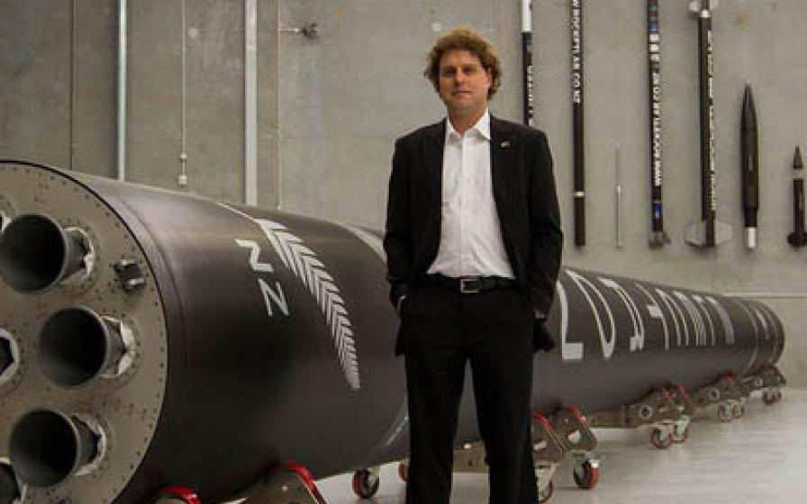
Q8
Peter Beck is the founder and CEO of what NZ Company?

Slide 11
Q9
What type of bridge is the Golden Gate Bridge in San Francisco?

Slide 12
Q10
Which British physicist wrote the 1988 book "A brief history of time: from the big bang to black holes"?

Slide 13
ANSWERS
ROUND 1 Junior Section Years 9-10

Slide 14
Q1: WHAT VITAMIN IS PRODUCED WHEN A PERSON IS EXPOSED TO SUNLIGHT?
ANSWER: VITAMIN D

Slide 15
Q2: THE INTENSITY OF SOUND IS MEASURED IN?
ANSWER: DECIBELS

Slide 16
Q3: HOW MANY EDGES HAS A CUBE?
ANSWER: 12

Slide 17
Q4: ON A SHIP, A DOGWATCH IS TRADITIONALLY HOW MANY HOURS LONG?
ANSWER: 2

Slide 18
Q5: AS THE OCEANS ABSORB MORE CO2 FROM A WARMING ATMOSPHERE, WILL THE PH OF THE OCEANS GO UP OR DOWN?
ANSWER: DOWN (DUE TO OCEAN ACIDIFICATION)

Slide 19
Q6: A MAGNIFYING GLASS IS WHAT TYPE OF LENS?
ANSWER: CONVEX

Slide 20
Q7: WHICH BRITISH PHYSICIAN DEVELOPED THE FIRST EFFECTIVE VACCINE AGAINST SMALLPOX?
ANSWER: EDWARD JENNER

Slide 21
Q8: PETER BECK IS THE FOUNDER AND CEO OF WHAT NZ COMPANY?
ANSWER: ROCKET LAB

Slide 22
Q9: WHAT TYPE OF BRIDGE IS THE GOLDEN GATE BRIDGE IN SAN FRANCISCO?
ANSWER: SUSPENSION BRIDGE

Slide 23
Q10: WHICH BRITISH PHYSICIST WROTE THE 1988 BOOK "A BRIEF HISTORY OF TIME: FROM THE BIG BANG TO BLACK HOLES"?
ANSWER: STEPHEN HAWKING

Slide 24
QUESTIONS
ROUND 2 Junior Section Years 9-10

Slide 25
Q11
What is the name of the phenomenon when the magnetosphere in the Northern Hemisphere is disturbed by the solar wind resulting in a natural light display?

Slide 26
Q12
The Māori word 'hangarau' refers to what? A: Science B: Technology C: Engineering D: Maths?

Slide 27
Q13
HTML and CSS are computer languages used to create what?

Slide 28
Q14
What family of elements is in the right-most column of the Periodic Table?

Slide 29
Q15
Which planet is named after the Roman god of war?

Slide 30
Q16
With what type of medication can bacterial infections in humans be treated?

Slide 31
Q17
What colour of the rainbow would score highest in scrabble?

Slide 32
Q18
What is the name for a substance that changes the speed of a chemical reaction without being affected itself?

Slide 33
Q19
'Cascade', 'horsetail', 'plunge' and 'tiered' are types of what?

Slide 34
Q20
What scientist is well known for his theory of relativity?

Slide 35
ANSWERS
ROUND 2 Junior Section Years 9-10

Slide 36
Q11: WHAT IS THE NAME OF THE PHENOMENON WHEN THE MAGNETOSPHERE IN THE NORTHERN HEMISPHERE IS DISTURBED BY THE SOLAR WIND RESULTING IN A NATURAL LIGHT DISPLAY?
ANSWER: AURORA BOREALIS (NORTHERN LIGHTS)

Slide 37
Q12: THE MĀORI WORD 'HANGARAU' REFERS TO WHAT? A: SCIENCE B: TECHNOLOGY C: ENGINEERING D: MATHS?
ANSWER: B: TECHNOLOGY

Slide 38
Q13: HTML AND CSS ARE COMPUTER LANGUAGES USED TO CREATE WHAT?
ANSWER: WEBSITES

Slide 39
Q14: WHAT FAMILY OF ELEMENTS IS IN THE RIGHT-MOST COLUMN OF THE PERIODIC TABLE?
ANSWER: NOBLE GASES (ACCEPT INERT GASES)

Slide 40
Q15: WHICH PLANET IS NAMED AFTER THE ROMAN GOD OF WAR?
ANSWER: MARS

Slide 41
Q16: WITH WHAT TYPE OF MEDICATION CAN BACTERIAL INFECTIONS IN HUMANS BE TREATED?
ANSWER: ANTIBIOTICS

Slide 42
Q17: WHAT COLOUR OF THE RAINBOW WOULD SCORE HIGHEST IN SCRABBLE?
ANSWER: YELLOW (12 POINTS)

Slide 43
Q18: WHAT IS THE NAME FOR A SUBSTANCE THAT CHANGES THE SPEED OF A CHEMICAL REACTION WITHOUT BEING AFFECTED ITSELF?
ANSWER: CATALYST

Slide 44
Q19: 'CASCADE', 'HORSETAIL', 'PLUNGE' AND 'TIERED' ARE TYPES OF WHAT?
ANSWER: WATERFALL

Slide 45
Q20: WHAT SCIENTIST IS WELL KNOWN FOR HIS THEORY OF RELATIVITY?
ANSWER: ALBERT EINSTEIN

Slide 46
PRACTICAL TASK
This year we have 3 practical challenges:
Year of the Periodic Table Challenge
Building Challenge
Coding Challenge

Slide 47
Year of the Periodic Table Challenge (3 marks)
What element is found in and “closely associated with” the 5 everyday items you have been given.

Slide 48
Building Challenge (4 marks)
Using only the equipment provided, build the tallest structure, as measured from the table surface to the top of the marshmallow. You have 15 minutes and should read the set of rules carefully
Over 5cm = 1 mark Over 20cm = 2 marks
Over 35cm = 2 marks Over 50cm = 4 marks

Slide 49
Coding Challenge (3 marks)
A Racetrack will be shown on screen and you must programme your team Bot to complete the circuit, from behind the Start line to over the Finish line. Instructions have been provided to each team
Reach Tyre Arch = 1 mark
Reach Man with Flag = 2 marks
Cross the finish line = 3 Marks

Slide 50
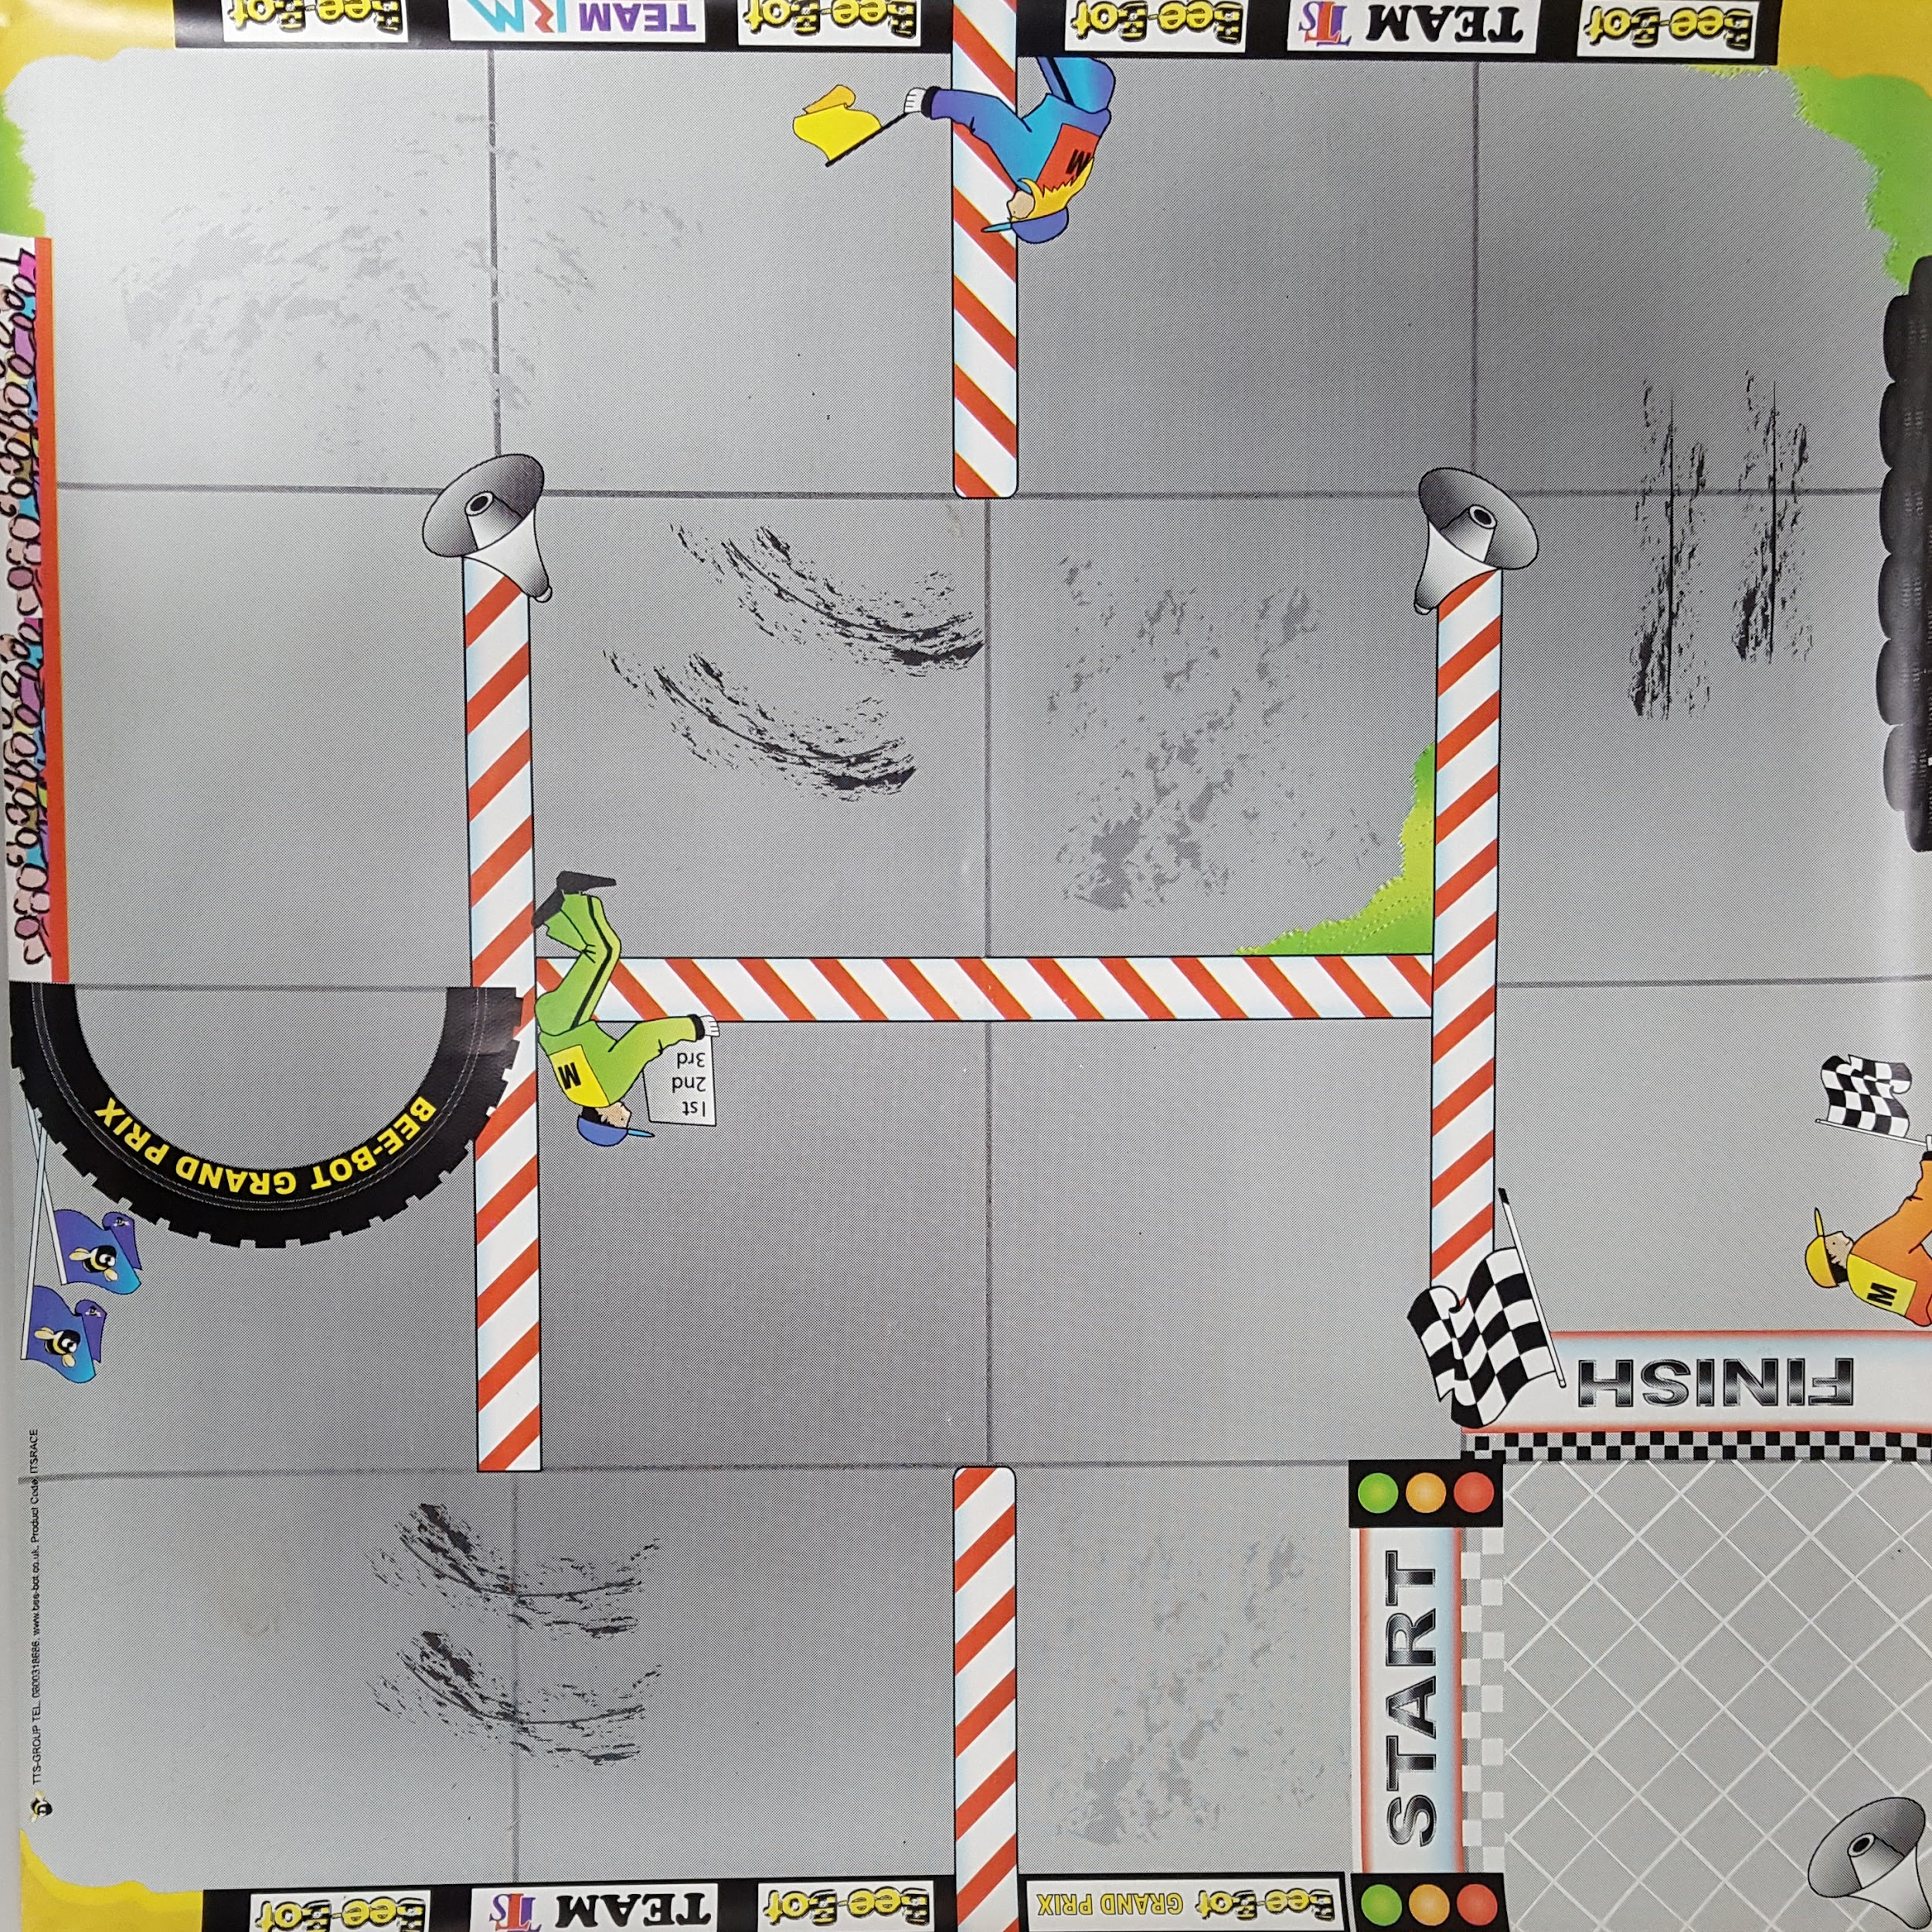

Slide 51
ELEMENT
CHALLENGE
ANSWERS

Slide 52
Year of the Periodic Table Challenge
A: Calcium D: Iron or
Magnesium
B: Lithium E:Sodium
C: Potassium E: Chloride

Slide 53
QUESTIONS
ROUND 4 Junior Section Years 9-10

Slide 54
Q21
True or false? Steel is a chemical element?

Slide 55
Q22
What was the name given to the sheep that was the first mammal cloned from an adult cell?

Slide 56
Q23
Electric current is measured using what device?

Slide 57
Q24
Which NZ bird is also known as Korimako and Makomako?

Slide 58
Q25
What is the common name for Sodium carbonate?

Slide 59
Q26
What is the largest 3-digit prime number?

Slide 60
Q27
In our solar system which two planets are known as ice giants?

Slide 61
Q28
What do people have an uncontrollable need to do if they suffer from narcolepsy?

Slide 62
Q29
How do macropods normally move about?

Slide 63
Q30
The iconic tree, Tāne Mahuta is in danger of becoming infected by what disease?

Slide 64
ANSWERS
ROUND 4 Junior Section Years 9-10

Slide 65
Q21: TRUE OR FALSE? STEEL IS A CHEMICAL ELEMENT?
ANSWER: FALSE - ALLOY

Slide 66
Q22: WHAT WAS THE NAME GIVEN TO THE SHEEP THAT WAS THE FIRST MAMMAL CLONED FROM AN ADULT CELL?
ANSWER: DOLLY

Slide 67
Q23: ELECTRIC CURRENT IS MEASURED USING WHAT DEVICE?
ANSWER: AMMETER

Slide 68
Q24: WHICH NZ BIRD IS ALSO KNOWN AS KORIMAKO AND MAKOMAKO?
ANSWER: BELLBIRD

Slide 69
Q25: WHAT IS THE COMMON NAME FOR SODIUM CARBONATE?
ANSWER: WASHING SODA

Slide 70
Q26: WHAT IS THE LARGEST 3-DIGIT PRIME NUMBER?
ANSWER: 997

Slide 71
Q27: IN OUR SOLAR SYSTEM WHICH TWO PLANETS ARE KNOWN AS ICE GIANTS?
ANSWER: URANUS AND NEPTUNE

Slide 72
Q28: WHAT DO PEOPLE HAVE AN UNCONTROLLABLE NEED TO DO IF THEY SUFFER FROM NARCOLEPSY?
ANSWER: SLEEP

Slide 73
Q29: HOW DO MACROPODS NORMALLY MOVE ABOUT?
ANSWER: BY HOPPING

Slide 74
Q30: THE ICONIC TREE, TĀNE MAHUTA IS IN DANGER OF BECOMING INFECTED BY WHAT DISEASE?
ANSWER: KAURI DIEBACK

Slide 75
QUESTIONS
ROUND 5 Junior Section Years 9-10

Slide 76
Q31
In electricity a negative electrode is called?

Slide 77
Q32
What is the next number in the Fibonacci sequence: 0, 1, 1, 2, 3, 5, 8, 13, 21, 34, ?

Slide 78
Q33
A very contentious method of pest control used widely in NZ that has been subject to widespread protests, is?

Slide 79
Q34
What is the only mammal born with horns?

Slide 80
Q35
Ferrum is the latin name for which metallic element?

Slide 81
Q36
What is the Roman numeral for 50?

Slide 82
Q37
Who discovered penicillin?

Slide 83
Q38
What animal's brain was recently 'brought back to life' by scientists?

Slide 84
Q39
The moon Titan orbits what planet?

Slide 85
Q40
SpaceX was founded by what South African-born inventor?

Slide 86
ANSWERS
ROUND 5 Junior Section Years 9-10

Slide 87
Q31: IN ELECTRICITY A NEGATIVE ELECTRODE IS CALLED?
ANSWER: CATHODE

Slide 88
Q32: WHAT IS THE NEXT NUMBER IN THE FIBONACCI SEQUENCE: 0, 1, 1, 2, 3, 5, 8, 13, 21, 34, ?
ANSWER: 5

Slide 89
Q33: A VERY CONTENTIOUS METHOD OF PEST CONTROL USED WIDELY IN NZ THAT HAS BEEN SUBJECT TO WIDESPREAD PROTESTS, IS?
ANSWER: 1080

Slide 90
Q34: WHAT IS THE ONLY MAMMAL BORN WITH HORNS?
ANSWER: GIRAFFE

Slide 91
Q35: FERRUM IS THE LATIN NAME FOR WHICH METALLIC ELEMENT?
ANSWER: IRON

Slide 92
Q36: WHAT IS THE ROMAN NUMERAL FOR 50?
ANSWER: L

Slide 93
Q37: WHO DISCOVERED PENICILLIN?
ANSWER: ALEXANDER FLEMING

Slide 94
Q38: WHAT ANIMAL'S BRAIN WAS RECENTLY 'BROuGHT BACK TO LIFE' BY SCIENTISTS?
ANSWER: PIG

Slide 95
Q39: THE MOON TITAN ORBITS WHAT PLANET?
ANSWER: SATURN

Slide 96
Q40: SPACEX WAS FOUNDED BY WHAT SOUTH AFRICAN-BORN INVENTOR?
ANSWER: ELON MUSK

Slide 97
Well done to all teams participating in STEMM Student Challenge 2019
huttscience.co.nz

Slide 98
TIE BREAKER

Slide 99
Question
What part of the human body contains five metacarpal bones?

Slide 100
Answer
The hand

Slide 101
Question
How many sides does a nonagon have?

Slide 102
Answer
9

Slide 103
Question
What is the most common metal found on Earth?

Slide 104
Answer
Iron

Slide 105
Question
What is the common name for sodium bicarbonate?

Slide 106
Answer
Baking soda

Slide 107
Question
Able to be seen from outer space, what is Earth's largest living structure?

Slide 108
Answer
The Great Barrier Reef

Slide 109
Question
True or false? Protons and neutrons are part of the nucleus?

Slide 110
Answer
True

Slide 111
Question
NZ's major oil refinery is sited on which headland at the entrance to Whangarei harbour?

Slide 112
Answer
Marsden Point

Slide 113
Question
Which mathematical symbol used in equations was invented by the Welsh mathematician Robert Recorde in 1557? ?

Slide 114
Answer
=

Slide 115
Question
Electric resistance is typically measured in what units?

Slide 116
Answer
Ohms

Slide 117
Question
What element produces the red colour in fireworks?

Slide 118
Answer
Strontium

