Slide 1
Science of Sound
Primary Science PLD

Slide 2
SCIENCE OF SOUND- Concept Overview
BIG IDEA – sound is a form of energy that can be transferred or transformed into other types of energy | BIG IDEA – properties of sound related to the manner in which sound waves travel through a substance | BIG IDEA- properties of musical instruments are related to manner in which they generate sound waves
If a sound carries large amounts of energy, hearing can be damaged | Sounds change as they move from one substance to another e.g. air to water | Materials used in musical instruments chosen for their properties of vibration
Sound energy is transferred to the substance it travels through, producing vibration | When air vibrates, loudness and pitch of sound depend on size and shape of air space | Musical instruments must make the air vibrate before we can hear the music
We hear when sound energy reaches ears, can travel thru solids, liquids and gases | The higher the frequency of the vibration, the higher the pitch of the sound | Sound from musical instrum. varies in pitch according to length, tension, thickness of vibrating material
The larger the vibration, the louder the sound | Sound travels as a wave, producing vibration | Musical instruments all make vibrations and have features to make different sounds
For sounds to be produced, something needs to move | Harder we strike/blow/pluck– louder the sound | We make sounds by striking/blowing/plucking
Our ears can hear difference in sounds | Sounds can be louder or softer, higher or lower | Sounds that we like can be combined to make music
Notes:
From Building Science Concepts 18 & 19

Slide 3
Simple Demonstrations
Vibrating Rulers – something has to move for sound to be produced
Slinky Spring – sound travels as a wave
Sound Hoses- vibrating air molecules
Palm Pipes – vibrating air molecules – different lengths, different notes
Sound meter – sound measured in decibels
Oscilloscope – visualizes sound waves

Slide 4
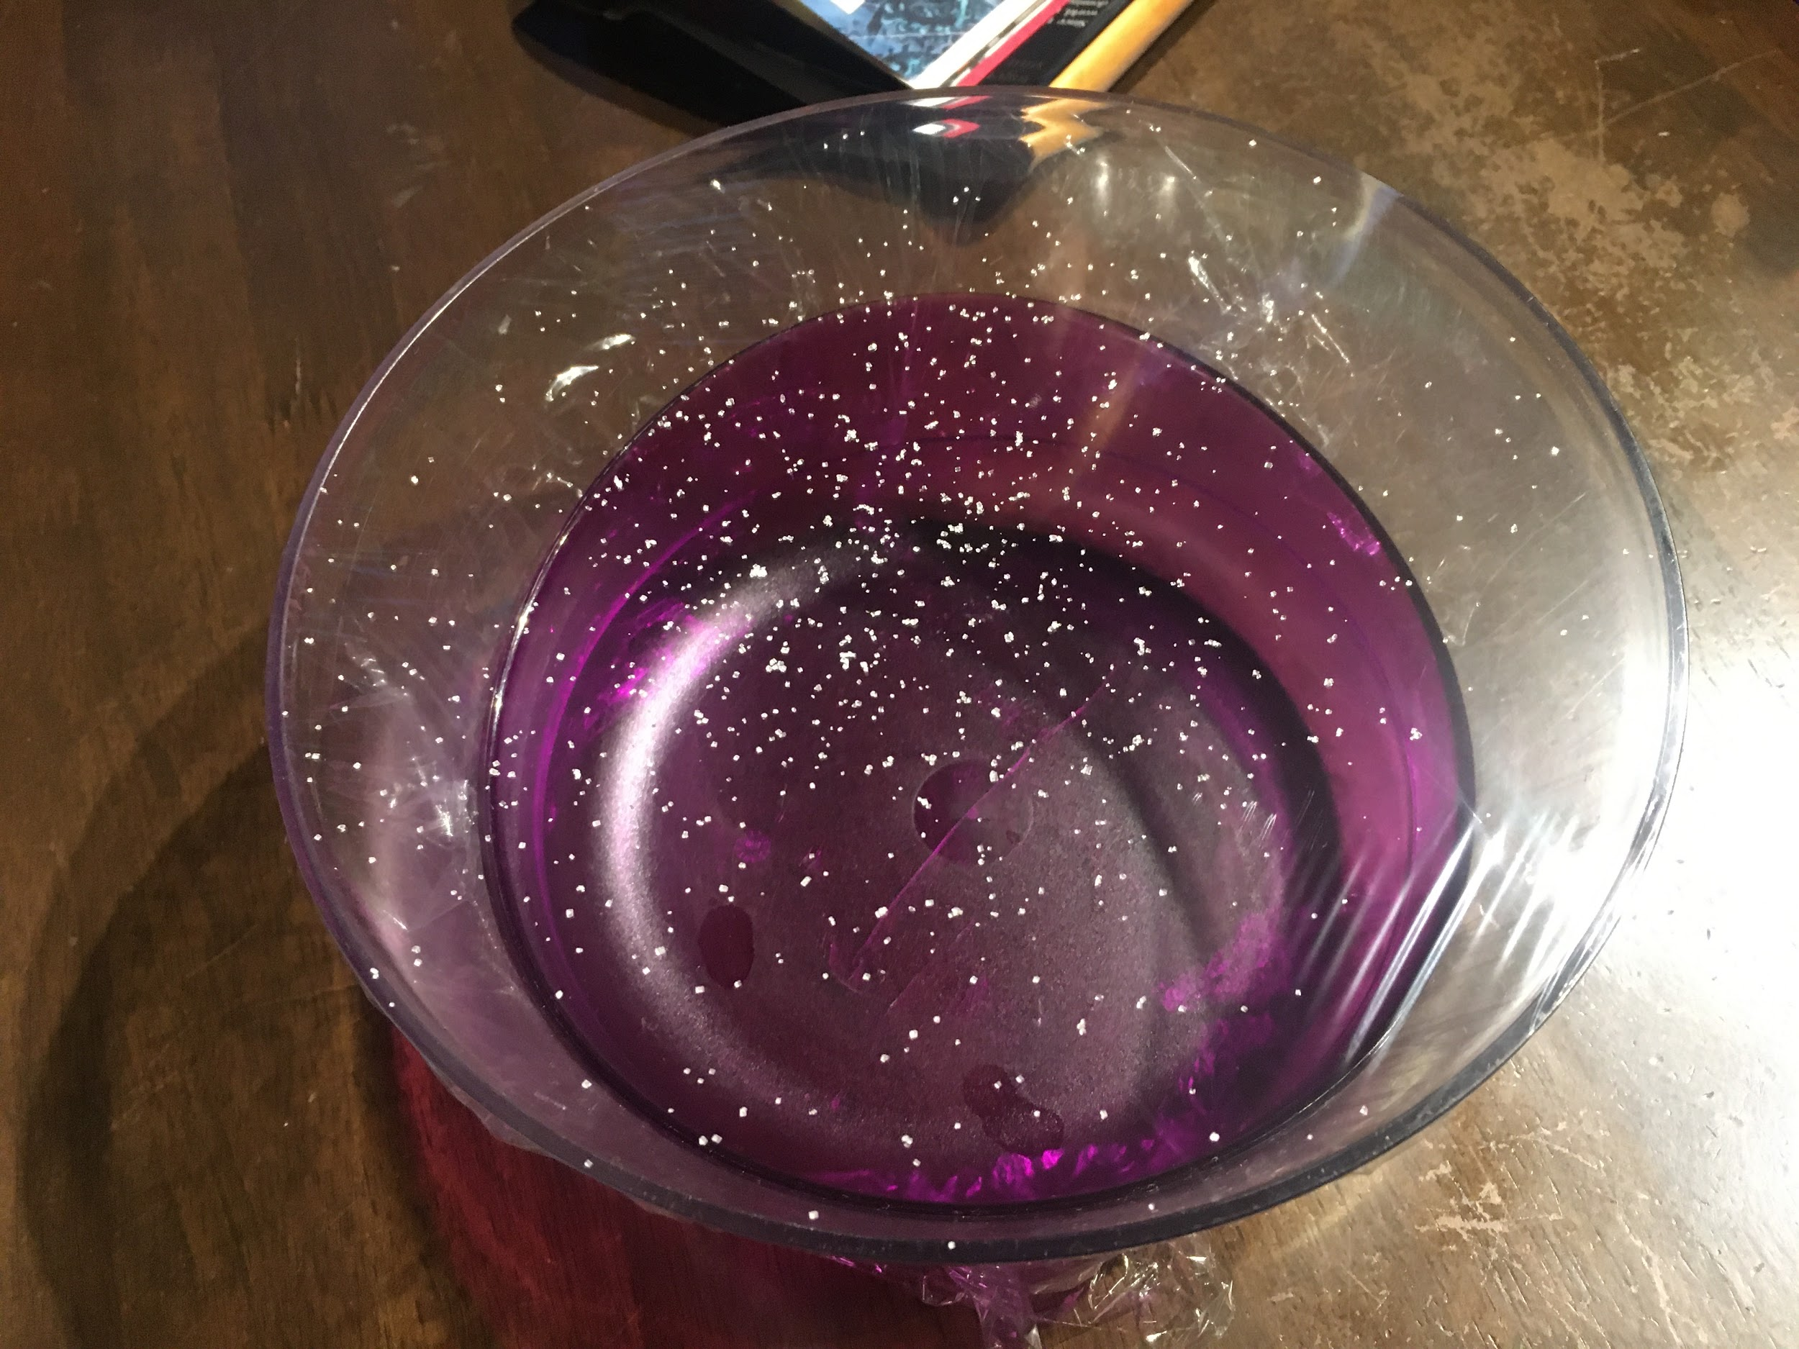
Sugar crystal - sound is a vibration
Stretch cling film tightly over a bowl. Sprinkle some sugar or salt crystals on top of the cling film.
Put your mouth close to the crystals and speak, whistle, or sing.
What do you see happening?
What happens if you are louder?

Slide 5
We can make vibrations, and hence sound, in a variety of ways

Slide 6
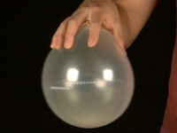
Screaming Balloon
Insert 8mm hex nut inside balloon
Blow up and tie off
Gently swirl in circle
Faster you swirl –
Faster the vibrations -
Higher the pitch

Slide 7
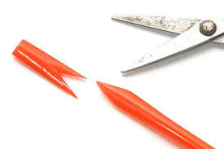
Straw Kazoos
Flatten one end of a straw. Cut the end to produce an outwards point in a V shape.
Put the pointed end in your mouth and blow through the straw - you may need to move the straw in and out until you find the right spot.
Try blowing through while (carefully) cutting a few centimetres from the end - what do you notice?
You can also cut small holes in the straw and cover or uncover them with your fingers.
Notes:
https://www.twinkl.co.nz/resource/au-sc-2122-straw-kazoo-craft-instructions

Slide 8
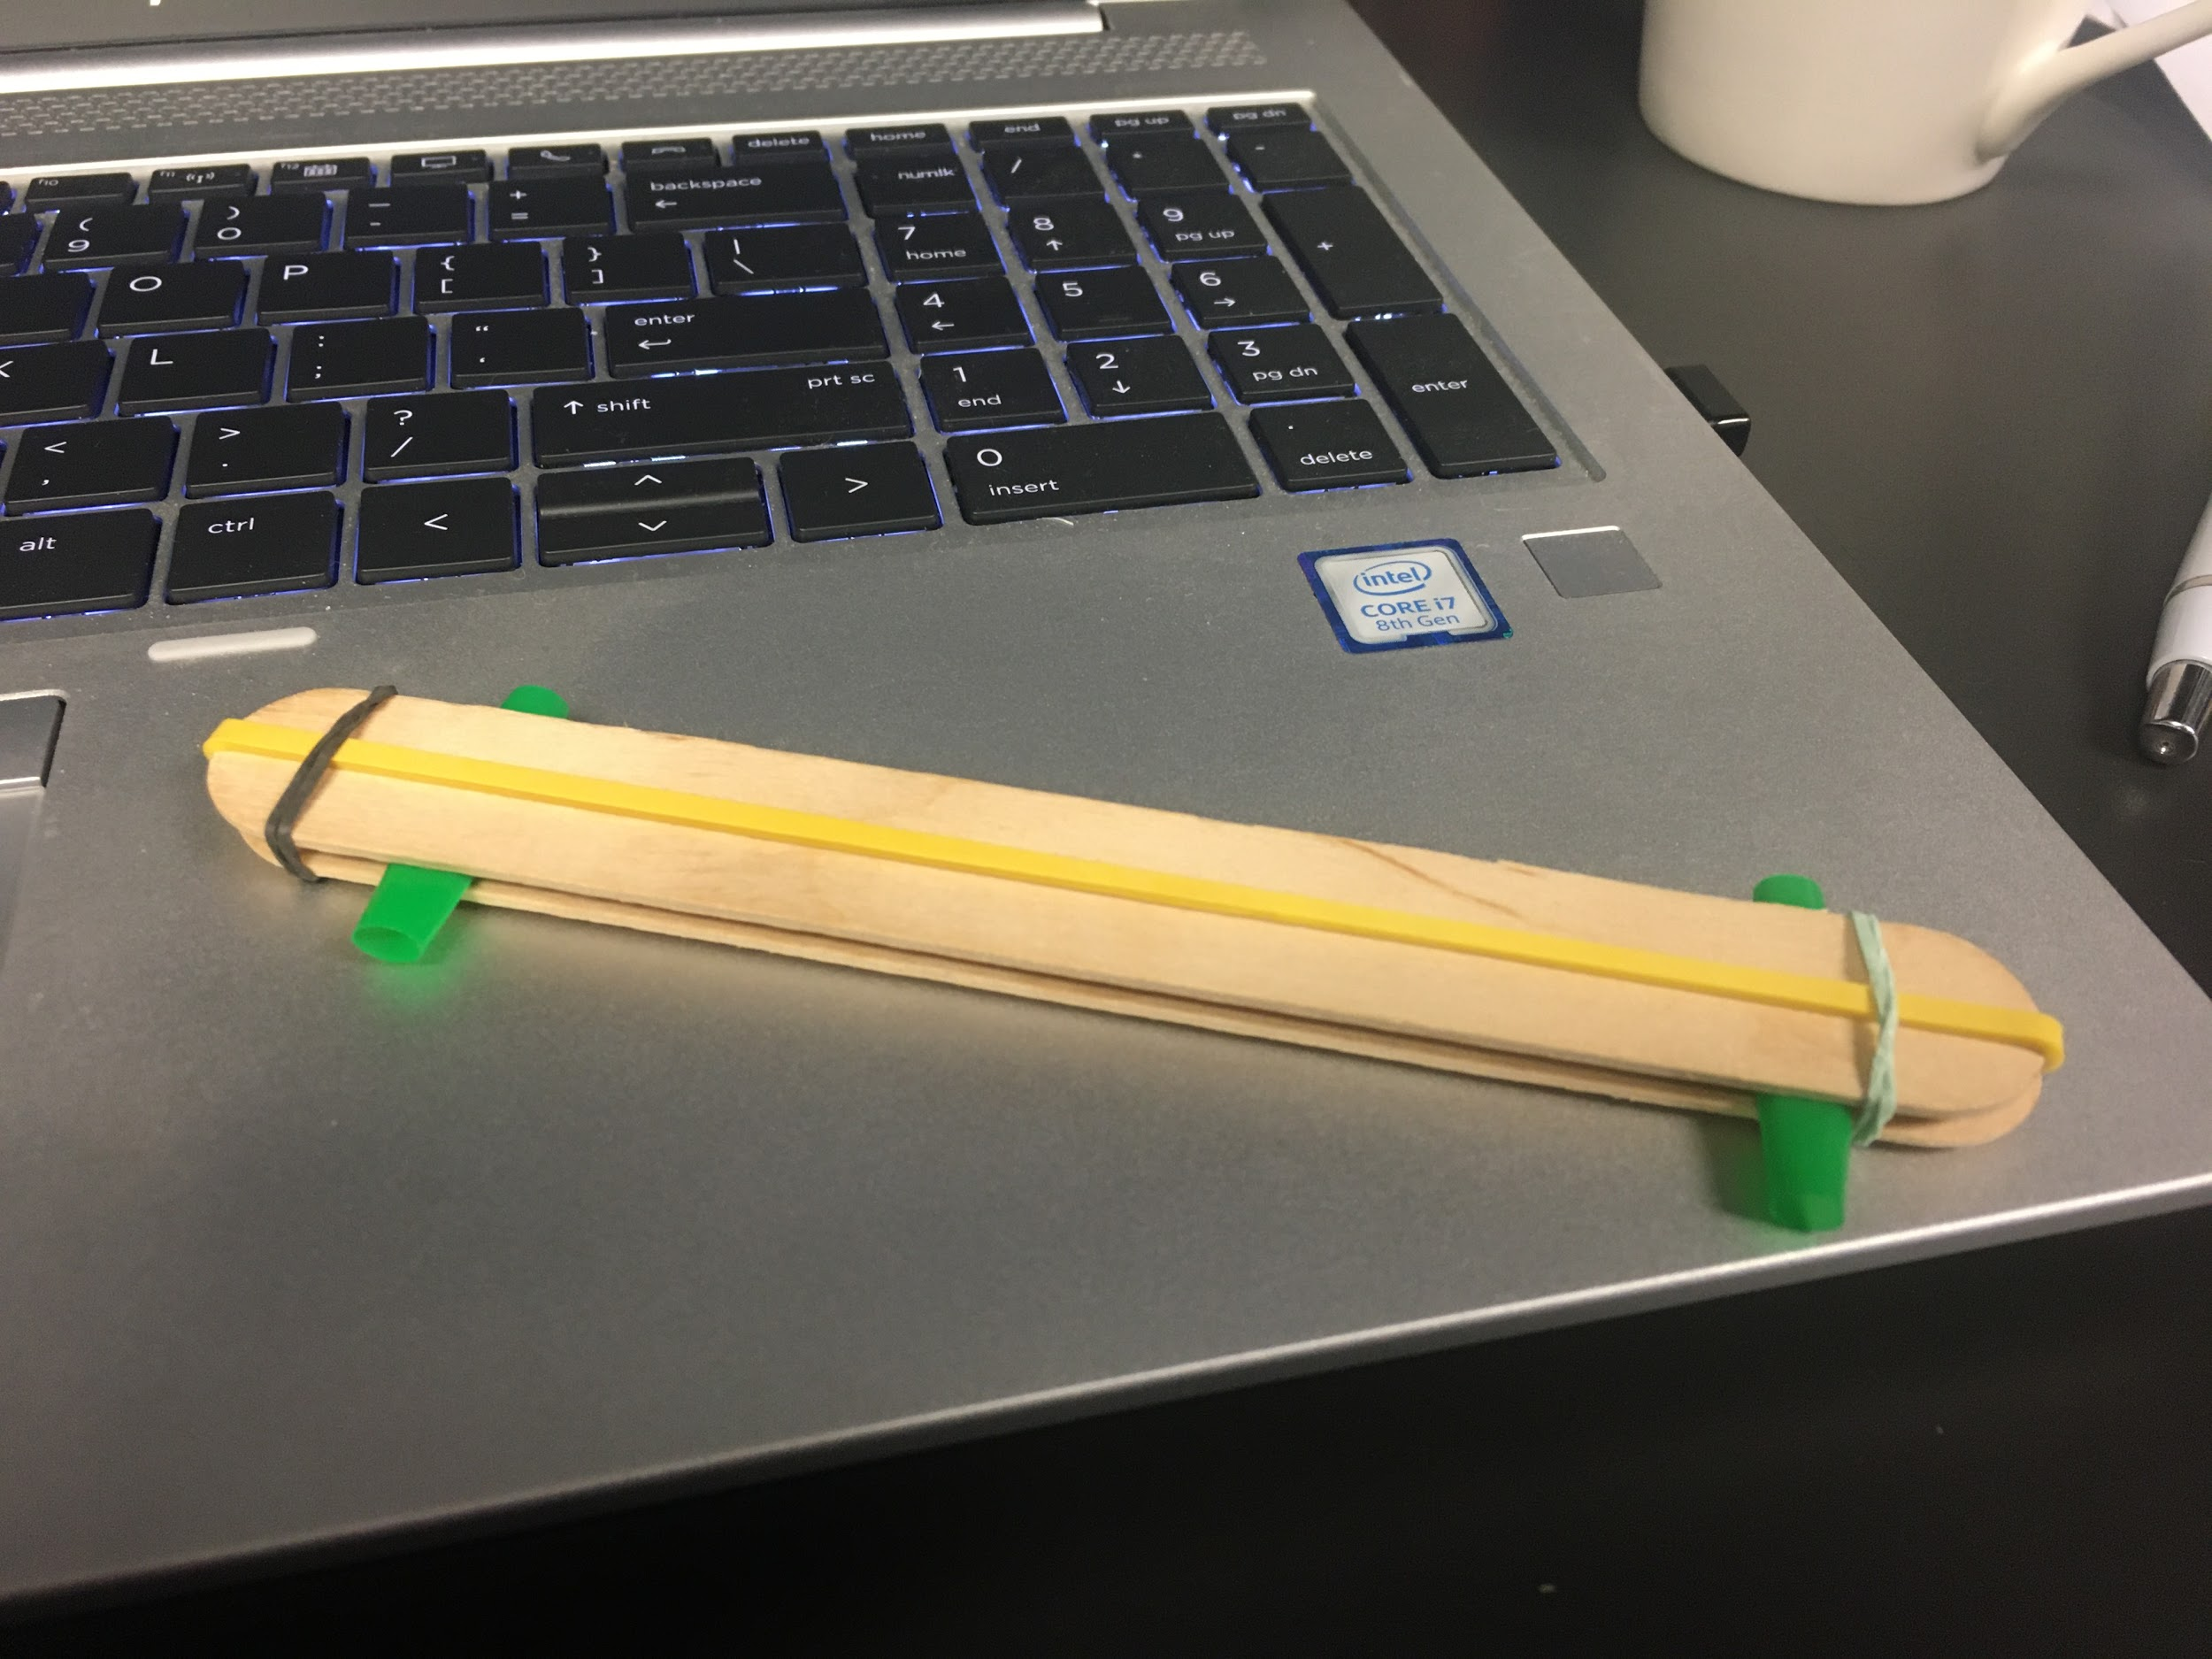
DIY Harmonica
Step 1: You Will Need. Scissors. ...
cut 2 pieces off the straw that are 1 inch in length.
take the rubber band and put it around 1 Popsicle stick.
take the 2 pieces of straw and lay them under the rubberband.
lay the other Popsicle stick on top.
now put the small rubber bands on 1 on each side.
Now you're done - blow through the gap between the two popsicle sticks
Notes:
https://www.instructables.com/id/Homemade-Harmonica/

Slide 9
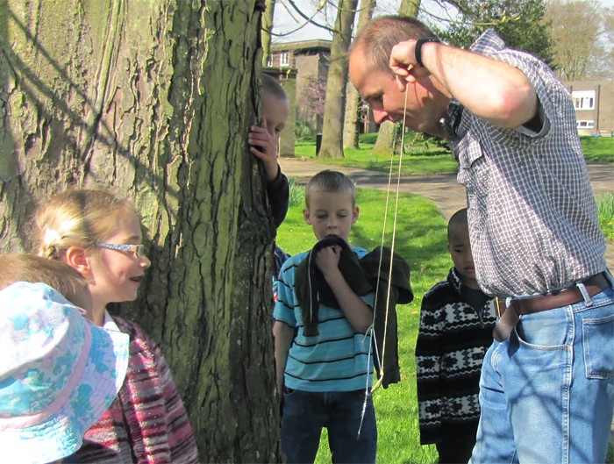
Coat hanger Gong
Holding by the strings gently knock the coat hanger on a hard surface - now wrap your fingers around each string and place your fingers in your ears and repeat
Sound travels faster through
solids (string) than they do
through gases (air) or liquids
change in sound
Notes:
Coathanger gong experiment
You will need:
1 Coat hanger 2 Pieces of string around 30cm in length. InstructionsTie the strings to the corners of the coat hanger.Hold the string in your hands so the coat hanger dangles downward. 3.Gently knock the coat hanger on a hard surface - is the sound loud or soft? 4.Wrap your fingers around each string and place your fingers in your ears. 5.Repeat the experiment with your fingers in your ear. Does the sound get louder or softer? Why?
Explanation: Sound is produced by vibrations. Vibrations travel faster through solids than they do through liquids or gases.This is the reason why earthquakes can be detected hundreds of kilometres from their source. Knocking the coat hanger against the surface makes the coat hanger vibrate. The vibrations travelled faster to your ear through the vibrating strings because they are solid.

Slide 10
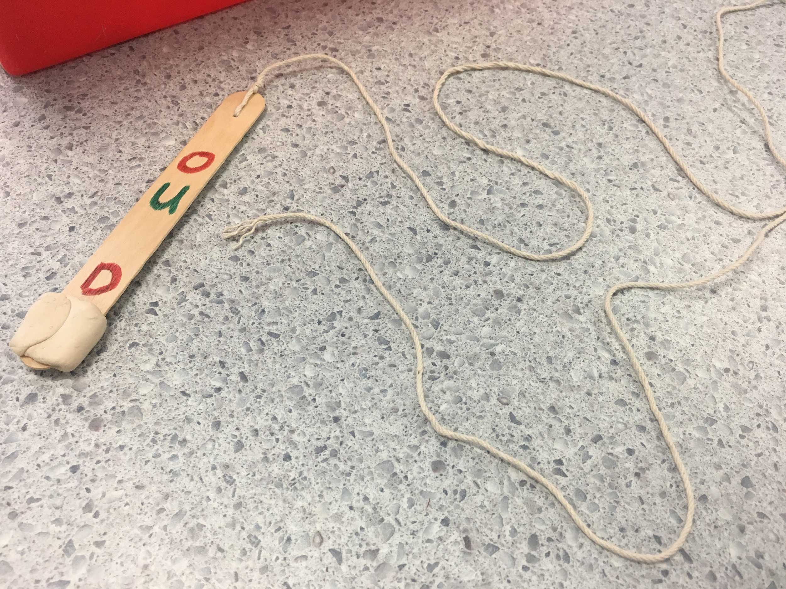
Bullroarer
Bore a hole in the centre of one end of a popsicle stick, and cut a notch in the centre of that end. Feed string through the hole and secure it through the notch before making a firm double knot. Works better with a lump of bluetack on the far end of the popsicle stick.
Hold the far end of the string and spin the popsicle stick around you - what do you notice?
You can also decorate each side of the stick and watch the effect when it spins.
Lots of opportunity for investigation here:
Width of popsicle stick, length of popsicle stick, amount (mass) of bluetack used, position of the hole, length of string when spinning, type of string used...
Notes:
https://www.exploratorium.edu/snacks/bee-hummer
https://www.youtube.com/watch?v=Gy05kWu88u0

Slide 11
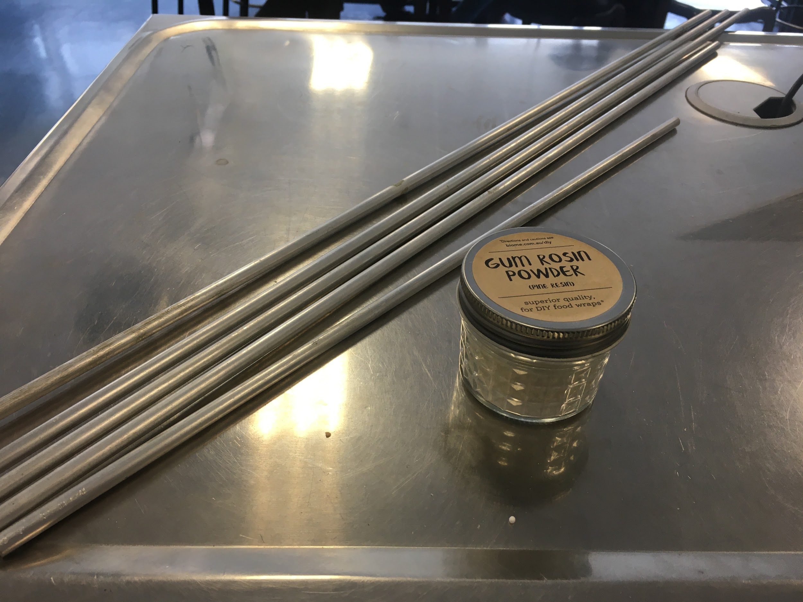
Singing rods
Hold an aluminium rod between finger and thumb. Adjust until the rod is balanced.
With a tiny amount of Gum Rosin powder on your other finger and thumb, pinch the rod and slide your pinching finger and thumb to the end.
What do you observe?

Slide 12
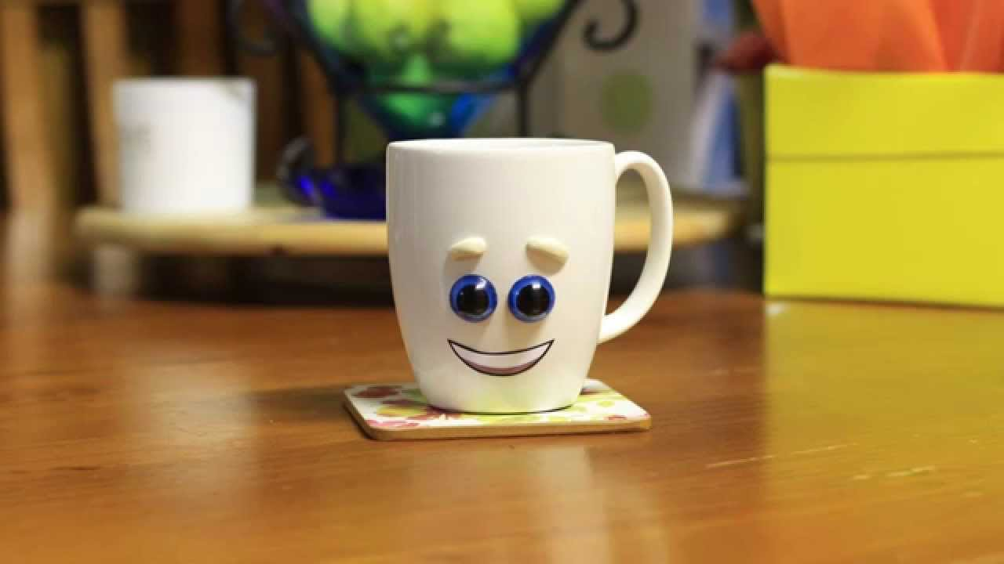
Talking Cup
Cup with string attached through hole in the bottom anchored with toothpick.
Fold and wet a paper towel and slide it down the length of the string.
Try alterations like using yarn instead of string, a larger or smaller cup, longer or shorter lengths of string.
The vibrations caused by the “sticking and sliding”of the wet paper on the string cause the cup to vibrate, which results in the amplification of sound.

Slide 13
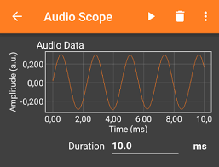
Phyphox - Audio Scope
Phyphox is a free app for your phone, with loads of really great gadgets.
The audio scope lets you visualise sounds as waves.

Slide 14
Bottle music
Fill bottles with varying levels of water and blow over the open top - using a straw helps your direct the air more precisely.
Experiment with different volumes of water.
Combine with audio scope to ‘see’ the sound wave

Slide 15
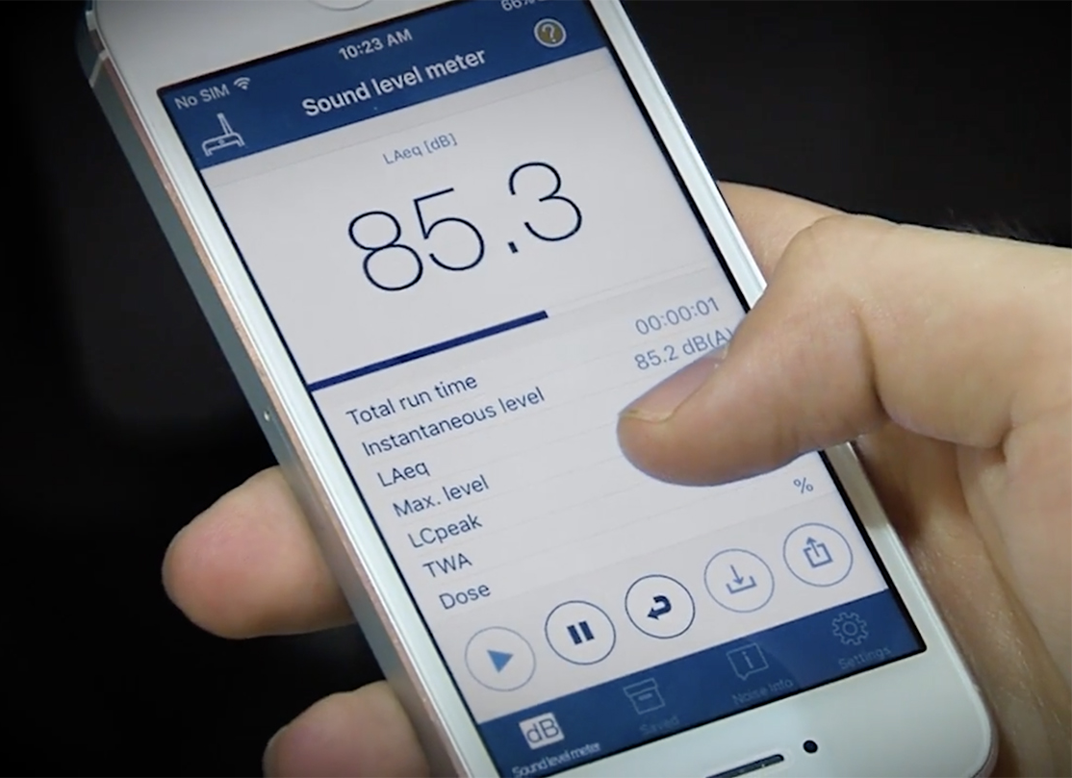
Measuring sound volume
The loudness or volume of sound is measured in decibels. There are free apps on Google and Apple stores.
Students could investigate volume, measuring how loud different sounds are before ranking them in order.
How would you ensure a fair test?

Slide 16
Science Week Student Challenge
Make a musical instrument using recyclable materials that is able to change pitch as well as volume. Make a video and share with NZASE
Lots of ideas, examples and links https://nzapse.nzase.org.nz/psw2020/

