Slide 1
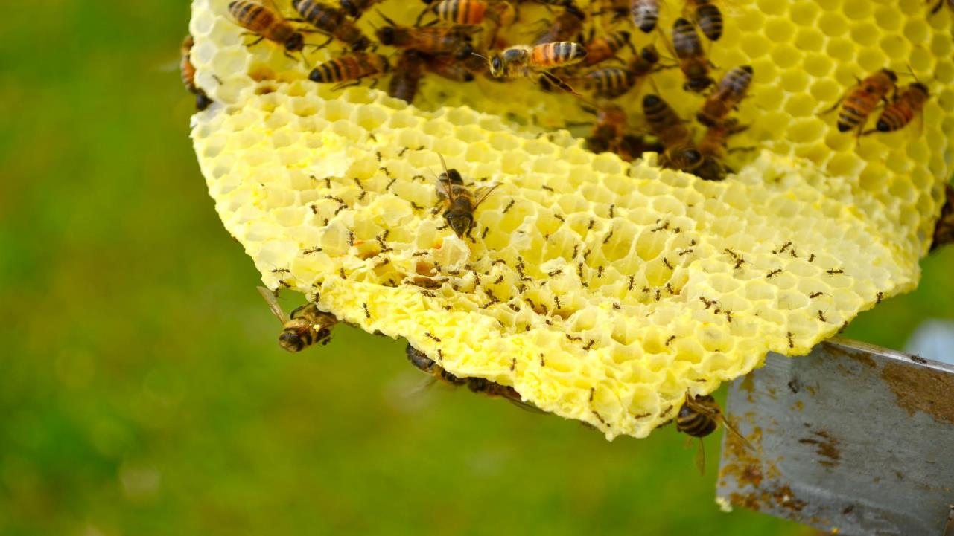

Honey bee hive collapse associated
with Argentine ants and viral pathogens
E.C Brenton-Rule¹, J. W Baty^{1,2}, J. Russell¹, M. Saunders³, P. J. Lester¹
¹School of Biological Sciences, Victoria University of Wellington
²Malaghan Institute of Medical Research
³Pinehaven Primary School, Upper Hutt

Slide 2
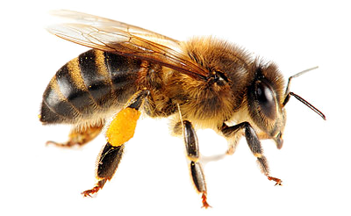

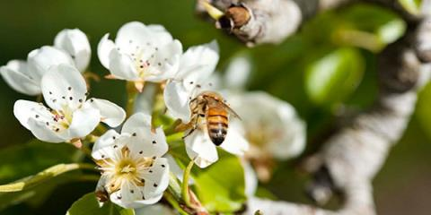

Importance of the honey bee
Honey bees and their management form the basis of global food security¹
Of the world’s 107 leading food commodities, 91 rely on bee pollination.
Worth US$235 – US$577 billion annually.
Without honey bees, the yield of these crops is reduced by up to 96%.
¹ Klein, et al., 2007 Importance of pollinators in changing landscapes for world crops. Proceedings of the Royal Society of London B: Biological Sciences, 274(1608), 303-313
² Gallai, et al., 2008 Economic valuation of the vulnerability of world agriculture confronted with pollinator decline. Ecological economics, 68(3), 810-821.

Slide 3
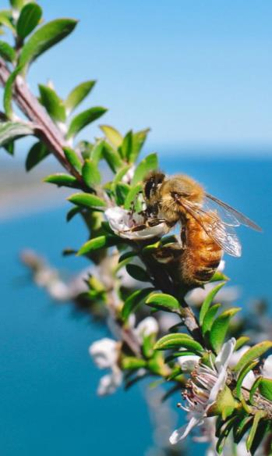

Apiculture in New Zealand
Apiculture is a growth industry
Globally, annual growth has averaged 10% between 2011 and 2016¹
In New Zealand, from 2005-2016 annual honey exports have increased from $25million to $280 million.¹
  Manuka (UMF 20+) price $40/kg up to $148/kg²
One of New Zealand’s fastest growing primary industries²
¹ United Nations Comtrade Database
² MPI (2016) Apiculture: Ministry for Primary Industries 2016 Apiculture Monitoring Programme

Slide 4
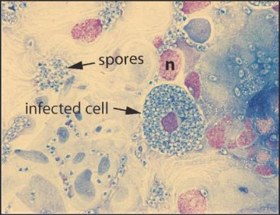
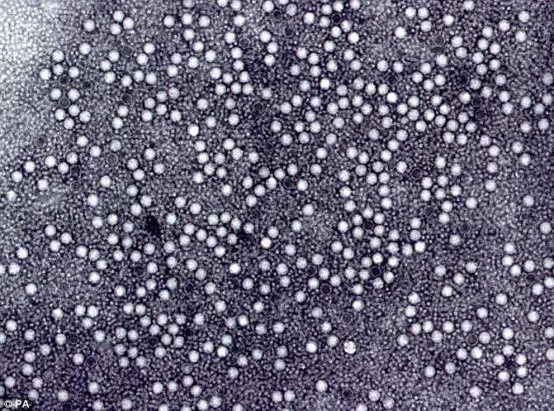
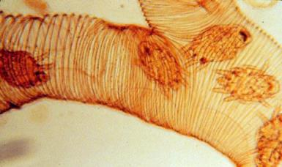
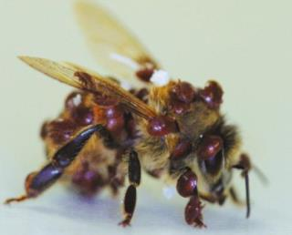
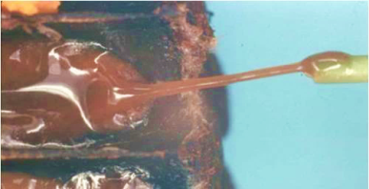
Threats to honey bees
Pathogens
  Endo- and ecto-parasites
  Fungi and bacterial infections
Nosema spores
Viruses
  Deformed wing virus (DWV)
  Kashmir bee virus (KBV)
  Israeli acute paralysis virus (IAPV)
DWV particles
Varroa mites
Tracheal mites
AFB
Notes:
There are many threats to honey bees.

Slide 5
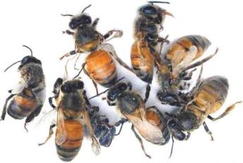
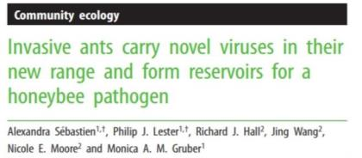
Deformed wing virus
Deformed wings
Reduce life expectancy to <67 hours¹
Suspected agents of global honey bee decline²
Infects a range of Hymenopterans
Skubník et al., 2016
¹Martin, S.J., 2001. The role of Varroa and viral pathogens in the collapse of honeybee colonies: a modelling approach. J. Appl. Ecol. 38, 1082–1093.
²Schroeder DC, Martin SJ. 2012. Deformed wing virus: The main suspect in unexplained honey bee deaths worldwide. Virulence 3: 589-591.

Slide 6
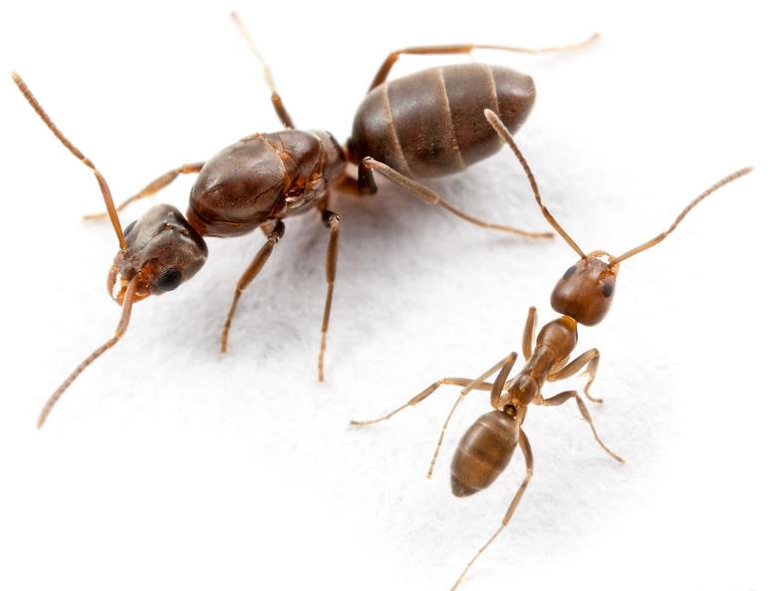
Invasive Argentine ant (Linepithema humile)
One of six most abundant, spatially
distributed and damaging invasive ant species
Unicolonial ²
  Individuals not aggressive towards one another
  Spread quickly via budding
A single introduction in Auckland in 1999
  Now present as far south as Christchurch and
  as far north as Cape Reinga
² Corin, S. E., et al. (2007) Large scale unicoloniality: the population and community structure of the invasive Argentine ant (Linepithema humile) in New Zealand. Insectes Sociaux 54: 275-282
Notes:
Antagonist

Slide 7
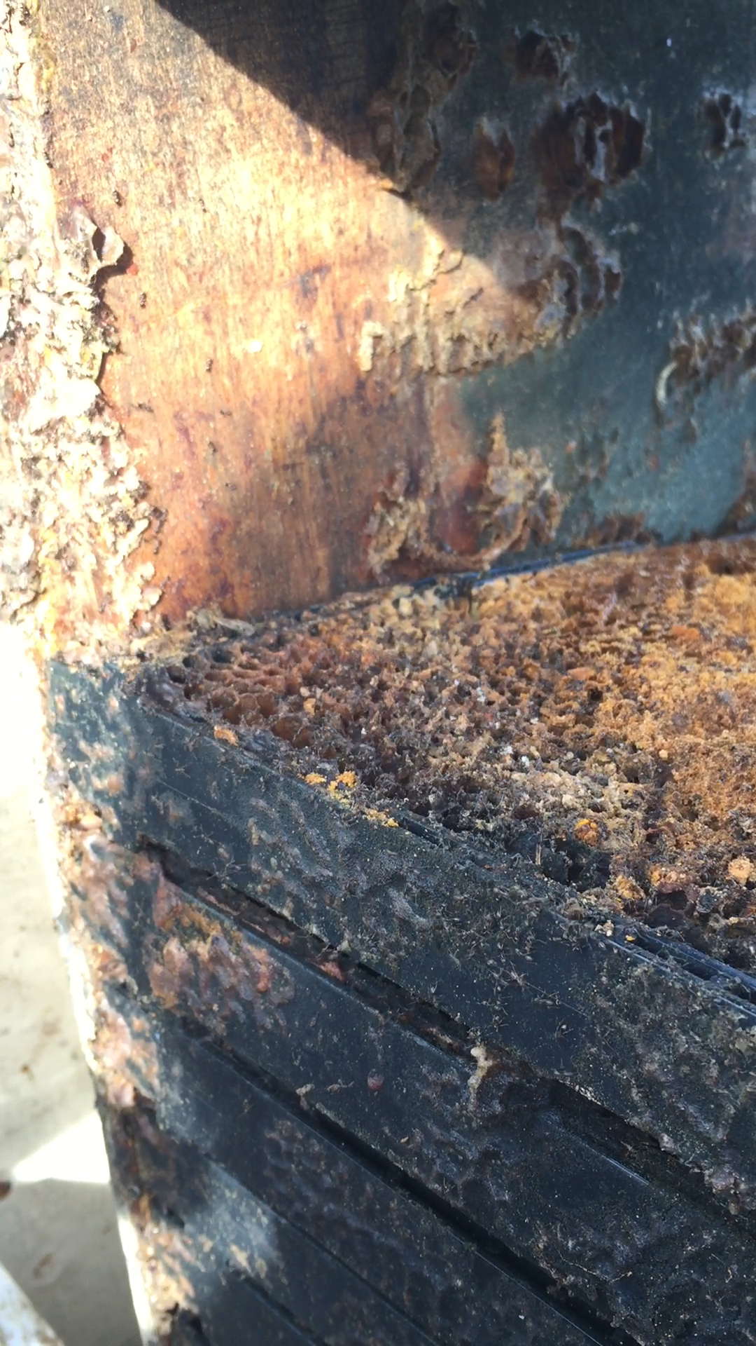
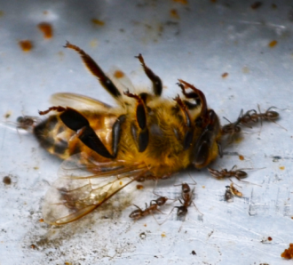
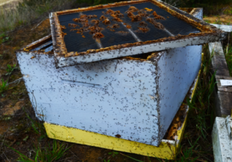

Argentine ant infestation in beehives
Reports from beekeepers in the Northland region of heavy ant infestation in hives
Predate on brood and ransacking honey and scavenging on dead adult bees

Slide 8
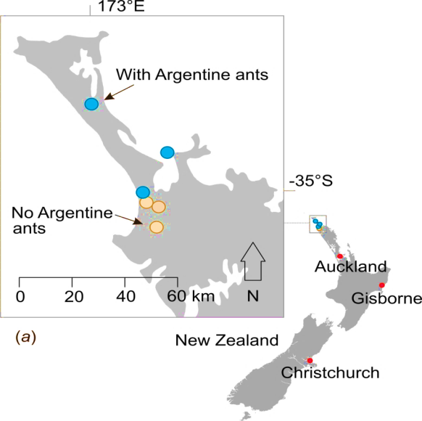
Investigation
We hypothesized that Argentine ants would have dual effects on honey bees:
  Direct effects (predation)
  Increased risk of disease
Surveyed beekeepers throughout NZ
Monthly monitoring of hives across six apiary sites over six months
  Blue = with Argentine ants
  Yellow = no Argentine ants
Sampling locations. Blue, apiaries with Argentine ants; yellow, apiaries with no ants. Red dots indicate known ant locations. Beekeepers have reported Argentine ant-induced hive mortality in areas from Gisborne northwards.

Slide 9
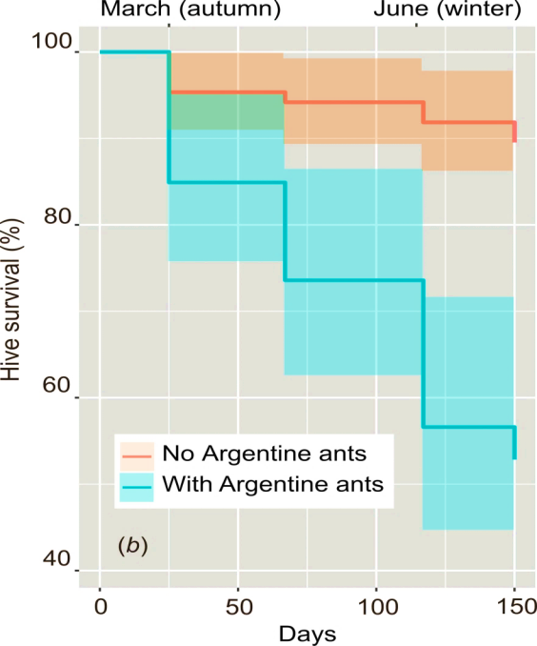
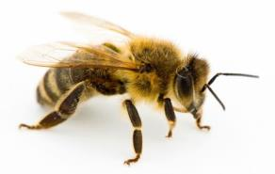

Hive mortality
Hive without ants had 89.5% survival over 150 days
Hives with ants present had only 52.8% survival
Survival curves for honey bee hives in areas with or without Argentine ants.
The coloured area around each line represents a 95% confidence interval.

Slide 10
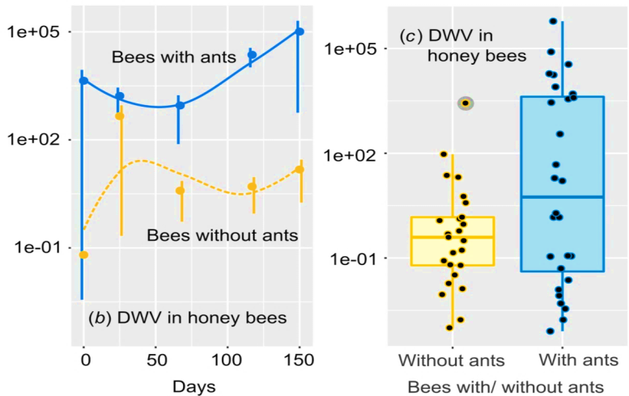
Viral infection
Viral loads of (b) DWV in honey bees when Argentine ants are present or absent. (C) shows all data for honey bee DWV loads from all sampling times. Note the log scale of the y-axis.

Slide 11
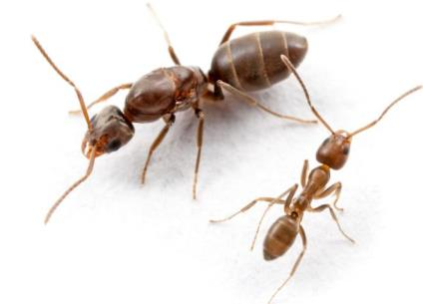
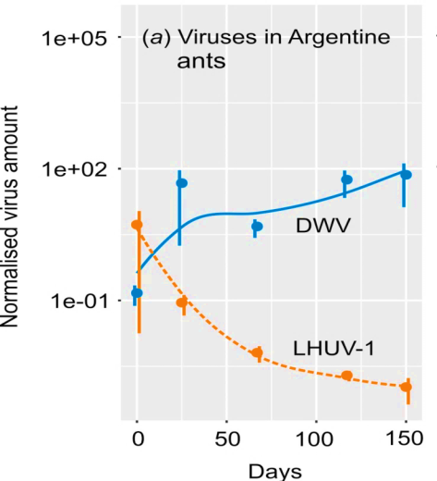
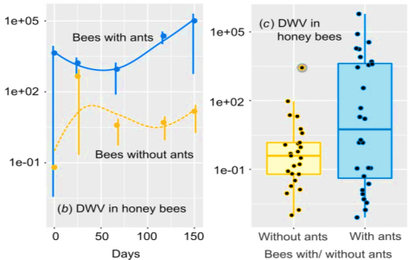
Viral infection

Slide 12
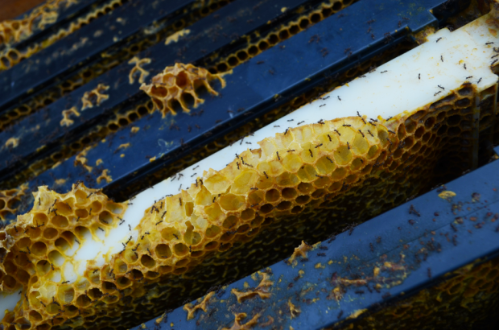
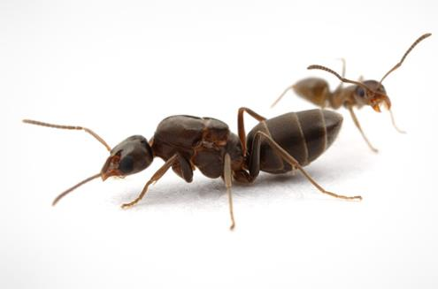
Easily spread
Unicoloniality¹
  Mediterranean colony 6000km
  Single NZ colony
No pesticide used by beekeepers to eradicate Argentine ants has been successful
Movement of hives spreads infestation
¹Corin, S. E., et al. (2007) Large scale unicoloniality: the population and community structure of the invasive Argentine ant
(Linepithema humile) in New Zealand. Insectes Sociaux 54: 275-282

Slide 13
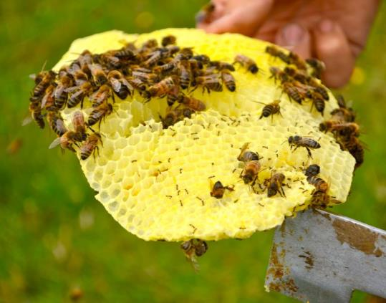
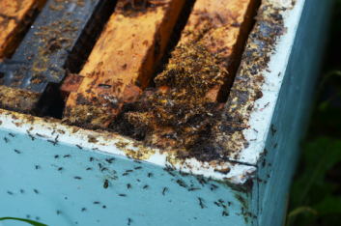
Conclusions
Invasive Argentine ants are correlated with severe hive mortality over short time frames
Bees with ants present have Deformed wing virus loads up to 220 times higher than when ants were not present
Correlation with ant presence and bee DWV infection
  Directly?
  Indirectly? – predation causing increased susceptibility to viruses?
Public awareness of ant threat and hive movement strategy reform required

Slide 14
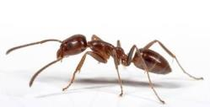



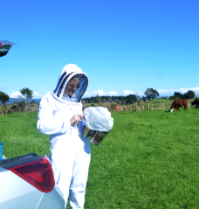


Acknowledgements
Phil Lester
James Baty
Evan Brenton-Rule
Marion Saunders
Northland’s beekeepers
!! DO NOT MOVE HIVES WITH ANTS !!

