Slide 1
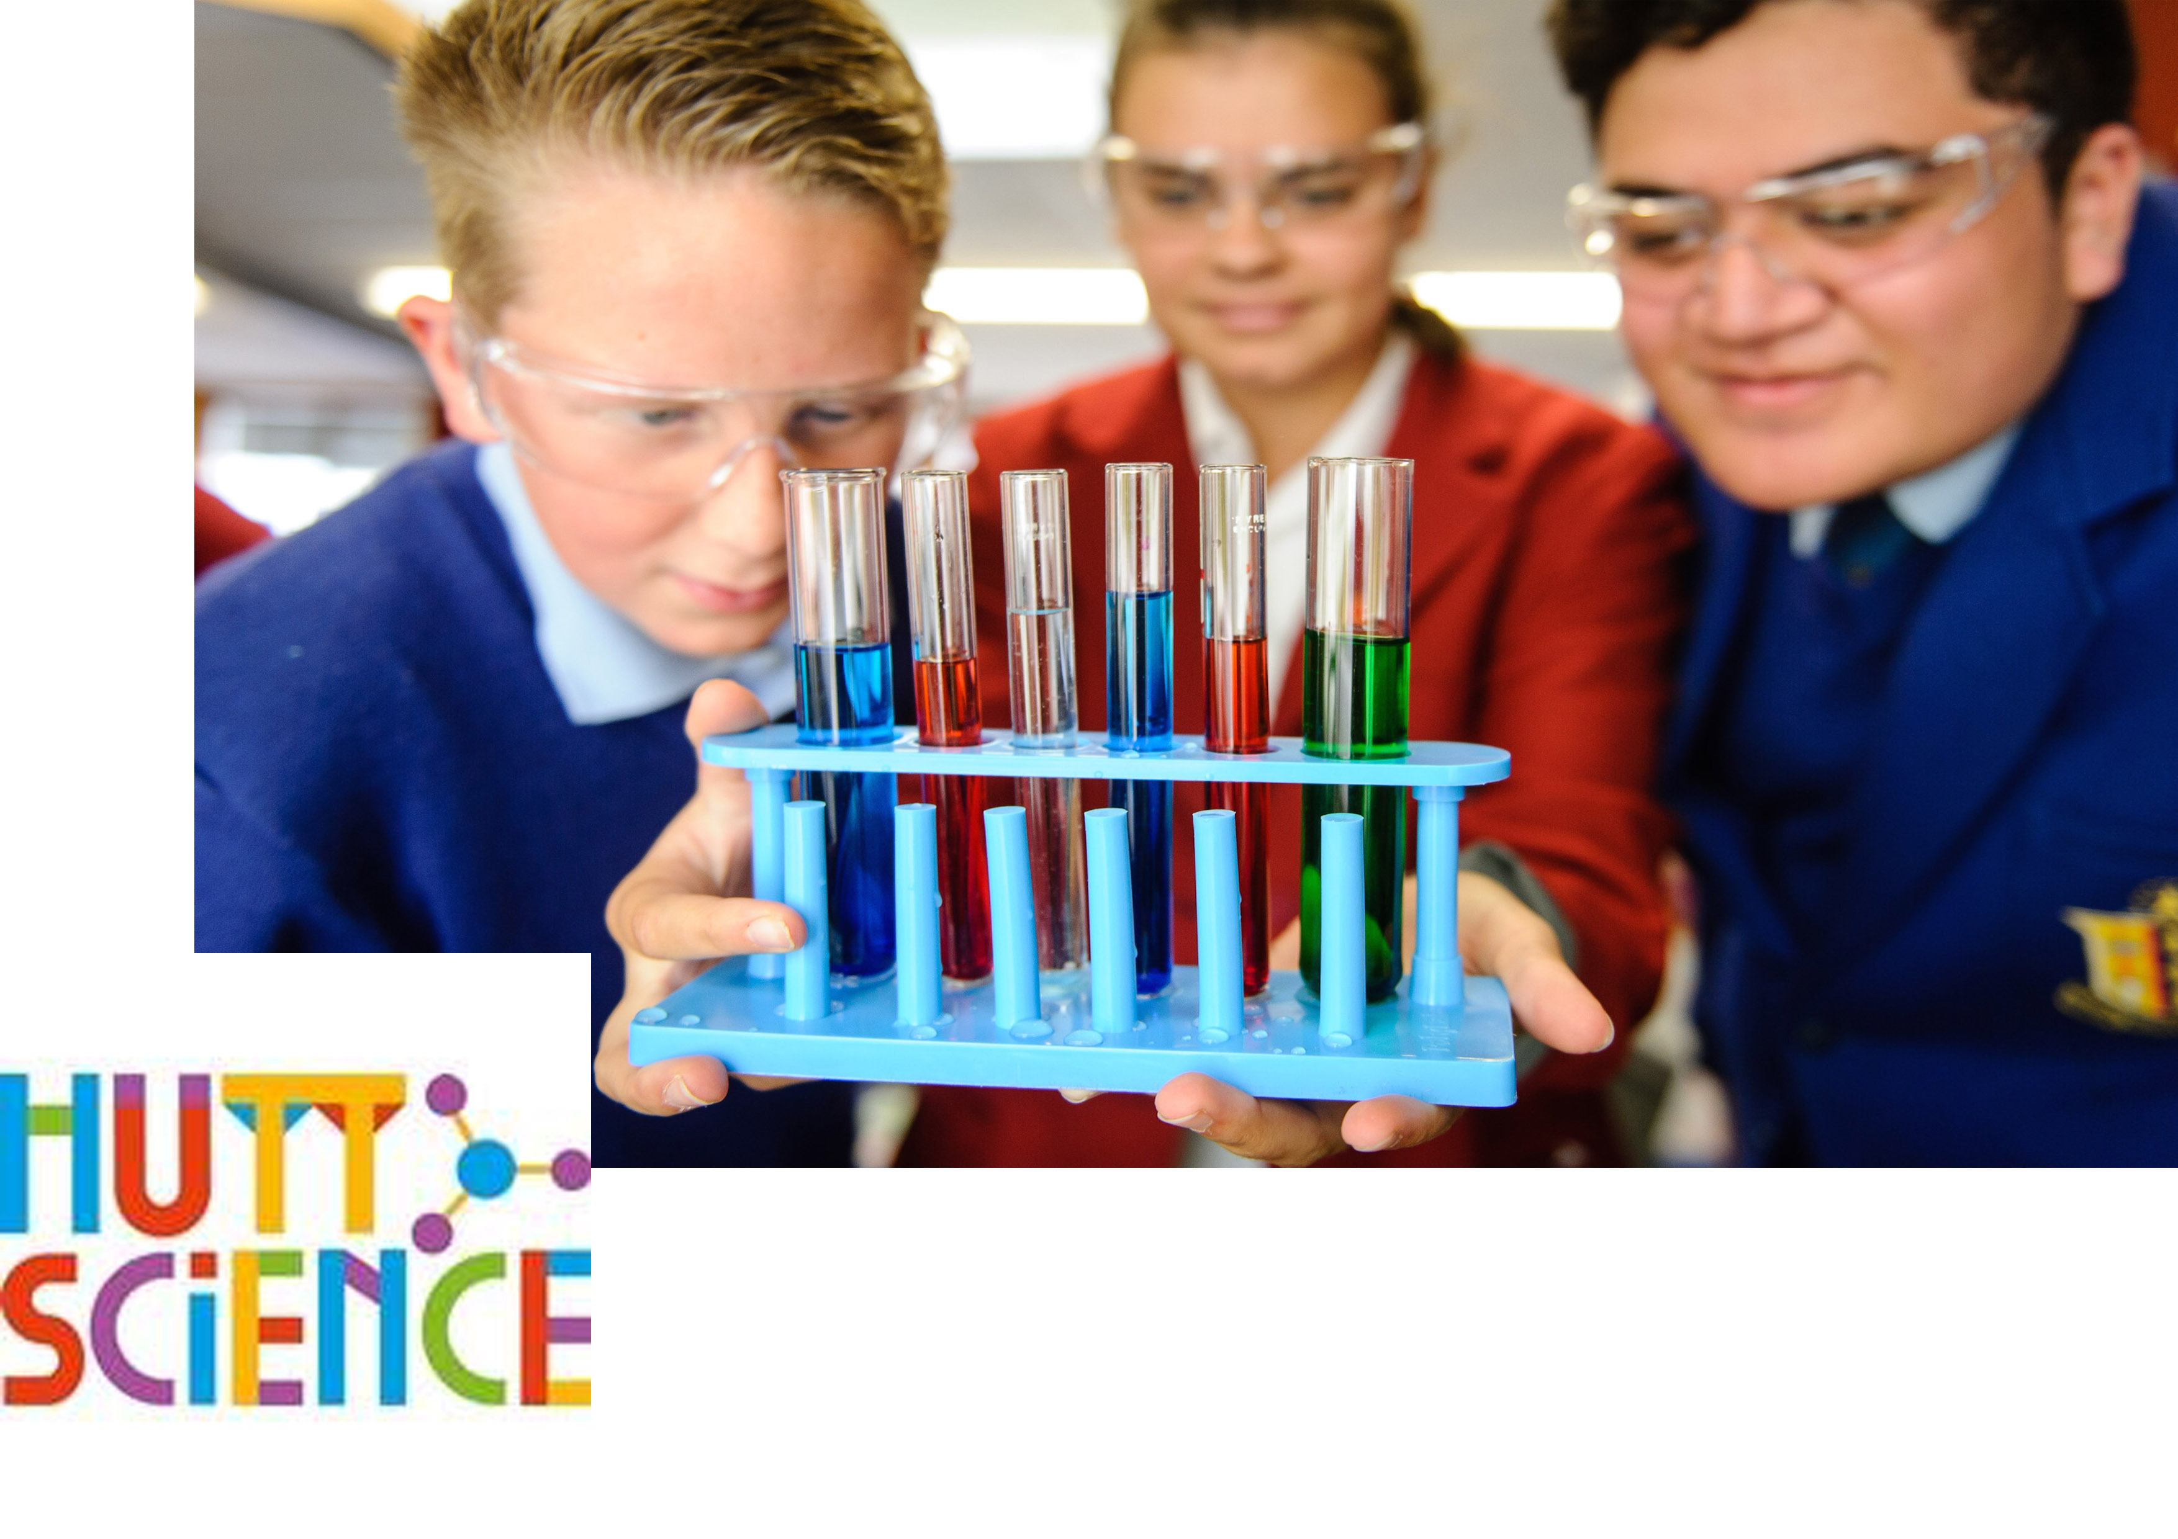
STEMM Student Challenge 2018

Slide 2
QUESTIONS
ROUND 1
Intermediate Section
Years 7-8

Slide 3
Q1
A group of lions is known as a what?

Slide 4
Q2
The movement of pollen from the anthers to the stigma of a flower is known as what?

Slide 5
Q3
True or false? Your ears are important when it comes to staying balanced?

Slide 6
Q4
What planet in the solar system is farthest from the Sun?

Slide 7
Q5
What girl's name doubles as the term for a female donkey?

Slide 8
Q6
How many of New Zealand's 40 native species of bees are honey producers?

Slide 9
Q7
What starts growing through a flounder's head when it's only a few weeks old?

Slide 10
Q8
True or false? Sound travels faster through water than air?

Slide 11
Q9
The three mustelids introduced into NZ are the stoat, weasel, and which other?

Slide 12
Q10
The bones around your chest that protect organs such as the heart are called what?

Slide 13
ANSWERS
ROUND 1
Intermediate Section
Years 7-8

Slide 14
Q1:
A group of lions is known as a what?
Answer: Pride

Slide 15
Q2:
The movement of pollen from the anthers to the stigma of a flower is known as what?
Answer: Pollination

Slide 16
Q3:
True or false? Your ears are important when it comes to staying balanced?
Answer: True

Slide 17
Q4:
What planet in the solar system is farthest from the Sun?
Answer: Neptune

Slide 18
Q5:
What girl's name doubles as the term for a female donkey?
Answer: Jenny

Slide 19
Q6:
How many of New Zealand's 40 native species of bees are honey producers?
Answer: Zero

Slide 20
Q7:
What starts growing through a flounder's head when it's only a few weeks old?
Answer: Eyes

Slide 21
Q8:
True or false? Sound travels faster through water than air?
Answer: True

Slide 22
Q9:
The three mustelids introduced into NZ are the stoat, weasel, and which other?
Answer: Ferret

Slide 23
Q10:
The bones around your chest that protect organs such as the heart are called what?
Answer: Ribs

Slide 24
QUESTIONS
ROUND 2
Intermediate Section
Years 7-8

Slide 25
Q11
Heat from the sun gets to the Earth by radiation, conduction or convection?

Slide 26
Q12
IMAGE Who is scientist Dr Michelle Dickinson better known as?

Slide 27
Q13
What is the name of a scientist who studies weather?

Slide 28
Q14
Which has more bones, an ankle or a wrist?

Slide 29
Q15
What is the first name of the famous scientist who gave us Newton’s three laws of motion?

Slide 30
Q16
Pure water has a pH level of a around what number?

Slide 31
Q17
How many vowels are there on the bottom row of a computer keyboard?

Slide 32
Q18
How many bends are there in the a standard paper clip?

Slide 33
Q19
Nimbus, cumulus and stratus are types of what?

Slide 34
Q20
Is a shark a fish or a mammal?

Slide 35
ANSWERS
ROUND 2
Intermediate Section
Years 7-8

Slide 36
Q11:
Heat from the sun gets to the Earth by radiation, conduction or convection?
Answer: Radiation

Slide 37
Q12:
IMAGE Who is scientist Dr Michelle Dickinson better known as?
Answer: Nanogirl

Slide 38
Q13:
What is the name of a scientist who studies weather?
Answer: A meteorologist

Slide 39
Q14:
Which has more bones, an ankle or a wrist?
Answer: A wrist

Slide 40
Q15:
What is the first name of the famous scientist who gave us Newton’s three laws of motion?
Answer: Isaac

Slide 41
Q16:
Pure water has a pH level of a around what number?
Answer: 7

Slide 42
Q17:
How many vowels are there on the bottom row of a computer keyboard?
Answer: None

Slide 43
Q18:
How many bends are there in the a standard paper clip?
Answer: Three

Slide 44
Q19:
Nimbus, cumulus and stratus are types of what?
Answer: Clouds

Slide 45
Q20:
Is a shark a fish or a mammal?
Answer: A fish

Slide 46
PRACTICAL TASK

Slide 49
QUESTIONS
ROUND 4
Intermediate Section
Years 7-8

Slide 50
Q21
What is desalinisation designed to remove from water?

Slide 51
Q22
A ‘doe’ is what kind of animal?

Slide 52
Q23
When solids reach their melting points they become what?

Slide 53
Q24
What would you have in a cast if you broke your ulna?

Slide 54
Q25
How many points are there on a pentagram?

Slide 55
Q26
The distance from the center of a circle to its edge is called what?

Slide 56
Q27
What is Arachnophobia?

Slide 57
Q28
True or false? Crocodiles have no sweat glands so they use their mouths to release heat?

Slide 58
Q29
How many sides does a banana have?

Slide 59
Q30
Balls or irregular lumps of ice that fall from clouds (often during thunderstorms) are known as what?

Slide 60
ANSWERS
ROUND 4
Intermediate Section
Years 7-8

Slide 61
Q21:
What is desalinisation designed to remove from water?
Answer: Salt

Slide 62
Q22:
A ‘doe’ is what kind of animal?
Answer: A female deer

Slide 63
Q23:
When solids reach their melting points they become what?
Answer: Liquids

Slide 64
Q24:
What would you have in a cast if you broke your ulna?
Answer: An arm

Slide 65
Q25:
How many points are there on a pentagram?
Answer: 5

Slide 66
Q26:
The distance from the center of a circle to its edge is called what?
Answer: The radius

Slide 67
Q27:
What is Arachnophobia?
Answer: Fear of spiders

Slide 68
Q28:
True or false? Crocodiles have no sweat glands so they use their mouths to release heat?
Answer: True - They often sleep with their mouth open to cool down

Slide 69
Q29:
How many sides does a banana have?
Answer: Five

Slide 70
Q30:
Balls or irregular lumps of ice that fall from clouds (often during thunderstorms) are known as what?
Answer: Hail stones

Slide 71
QUESTIONS
ROUND 5
Intermediate Section
Years 7-8

Slide 72
Q31
How many seasons are there in 7 ½ years
?

Slide 73
Q32
How many elbows does a dog have?

Slide 74
Q33
What's obtained by multiplying the base of a triangle by its height and dividing by two?

Slide 75
Q34
Domestic cattle are ruminants that have stomachs divided into how many chambers?

Slide 76
Q35
What is the second most common gas found in the air we breathe?

Slide 77
Q36
What comes after a million, billion and trillion?

Slide 78
Q37
True or false? Gold is a good conductor of electricity?

Slide 79
Q38
IMAGE Who is this famous scientist?

Slide 80
Q39
Bees are found on every continent of earth except for one, which is it?

Slide 81
Q40
Firefox, Opera, Chrome, Safari and Explorer are types of what?

Slide 82
ANSWERS
ROUND 5
Intermediate Section
Years 7-8

Slide 83
Q31:
How many seasons are there in 7 ½ years
?
Answer: 30

Slide 84
Q32:
How many elbows does a dog have?
Answer: Two

Slide 85
Q33:
What's obtained by multiplying the base of a triangle by its height and dividing by two?
Answer: It's area

Slide 86
Q34:
Domestic cattle are ruminants that have stomachs divided into how many chambers?
Answer: 4

Slide 87
Q35:
What is the second most common gas found in the air we breathe?
Answer: Oxygen (21%)

Slide 88
Q36:
What comes after a million, billion and trillion?
Answer: A quadrillion

Slide 89
Q37:
True or false? Gold is a good conductor of electricity?
Answer: True

Slide 90
Q38:
IMAGE Who is this famous scientist?
Answer: Albert Einstein

Slide 91
Q39:
Bees are found on every continent of earth except for one, which is it?
Answer: Antarctica

Slide 92
Q40:
Firefox, Opera, Chrome, Safari and Explorer are types of what?
Answer: Web\Internet browsers

Slide 93
Well done to all teams participating in STEMM Student Challenge 2017
huttscience.co.nz

Slide 94
TIE BREAKER

Slide 95
Question
What is the name of the biggest part of the human brain?

Slide 96
Answer
The cerebrum

Slide 97
Question
A farmer fences a paddock in the shape of a regular Hexagon. He counts up and finds that he has 22 posts along one fence line. How many posts will be in the entire fence line?

Slide 98
Answer
126

Slide 99
Question
Now that Pluto is no longer included, how many planets are there in the Solar System?

Slide 100
Answer
8

Slide 101
Question
What is the name of an adult female horse?

Slide 102
Answer
A mare

Slide 103
Question
Water is made up of what two elements?

Slide 104
Answer
Hydrogen and oxygen

Slide 105
Question
What are baby goats called?

Slide 106
Answer
Kids

Slide 107
Question
What do you call a person who studies rocks?

Slide 108
Answer
A geologist

Slide 109
Question
What is the brightest planet in the night sky?

Slide 110
Answer
Venus

Slide 111
Question
What angle exists, between the hands of an analog clock (that's the one where the hands go around), if the time is: 7 o'clock?

Slide 112
Answer
150 degrees or 210 degrees

Slide 113
Question
Salamanders are classified as members of which animal class?

Slide 114
Answer
Amphibia

